Slide 1

Noida Institute of Engineering and Technology, Greater Noida
Hypothesis Tests and Control Charts
Module 5
Subject Name: Statistics and Probability
Subject Code: BAS0303N
Dr. Lokesh Chaudhary
Department of Mathematics
B Tech 3rd Sem

Slide 2
Syllabus
Module 1: (Statistical Techniques-I)
Introduction: Measures of central tendency: Mean, Median, Mode, Standard deviation, Quartile deviation, Moment, Skewness, Kurtosis.
Module 2: (Statistical Techniques-II)
Curve Fitting, Method of least squares, fitting of straight lines, Fitting of second-degree parabola, Exponential curves, Correlation and Rank correlation, Linear regression, nonlinear regression and multiple linear regression.
Module 3: (Probability and Random Variable)
Random Variable: Definition of a Random Variable, Discrete Random Variable, Continuous Random Variable, Probability mass function, Probability Density Function, Distribution functions.
Multiple Random Variables: Joint density and distribution Function, Properties of Joint Distribution function, Marginal density Functions, Conditional Distribution and Density, Statistical Independence, Central Limit Theorem (Proof not expected).

Slide 3
Syllabus
Module 4: (Expectations and Probability Distribution)
Expectations of single Random Variable, Mean, Variance, Moment Generating Function, Binomial, Poisson, Normal, Exponential distribution.
Module 5: (Hypothesis Tests and Control Charts)
Testing a Hypothesis, Null hypothesis, Alternative hypothesis, Level of significance, Confidence limits, Test of significance of difference of means, Z-test, t-test and Chi-square test, F-test, One way ANOVA.
Statistical Quality Control (SQC), Control Charts, Control Charts for variables (Mean and Range Charts), Control Charts for Variables (p, np and C charts).

Slide 4
Branch Wise Application
Data Analysis
Artificial intelligence
Network and Traffic modeling

Slide 5
Course Objectives
The objective of this course is to familiarize the students with concepts of Probability and statistical techniques. It aims to equip the students with adequate Knowledge of statistics that will enable them in formulating Problems and solving problems analytically.
The students will learn:
Understand the concept of correlation, moments, skewness and kurtosis and curve fitting.
Apply the concept of hypothesis testing and statistical quality control to create control charts.
Remember the concept of probability to evaluate probability distributions.
Understand the concept of Mathematical Expectations and Probability Distribution.

Slide 6
Course Outcomes
CO1: Apply the concept of moments, skewness and kurtosis in relevant field.
CO2: Apply the concept of correlation, regression and curve fitting with real world problems.
CO3: Apply the concept of probability and random variable.
CO4: Apply the concept of Mathematical Expectations and Probability Distribution in real life problems.
CO5: Apply the concept of hypothesis testing and statistical quality control to create control charts.

Slide 7
Prerequisite and Recap
Knowledge of Maths 1 B.Tech.
Knowledge of Maths 2 B.Tech.
Knowledge of Permutation and Combination.

Slide 8
Module Content
Testing a Hypothesis,
Null and Alternative hypothesis
Level of significance
Confidence limits
p-value
Test of significance of difference of means:
Z-test
t-test
Chi-square test
F-test
ANOVA: One way and Two way
Statistical Quality Control (SQC)
Control Charts
Control Charts for variables (Mean and Range Charts)
Control Charts for Variables ( p, np and C charts).

Slide 9
Module Objective(CO5)
The objective of this course is to familiarize the engineers with Statistical techniques and its applications in real world.
The concept of hypothesis, ANOVA and quality control by control charts.

Slide 10
Topic objective (CO5)
Test of Hypothesis
Describe real-life examples to explain the motivation behind hypothesis

Slide 11
Test of Hypothesis (CO5)
Test of Hypothesis:
Some information about a characteristic of the population is known, we wish to know whether the information can be accepted or rejected, we choose a random sample and obtain information about the characteristic, based on this information.
we conclude whether the available information of the characteristic of the population can be accepted or rejected. This is called Test of hypothesis.

Slide 12
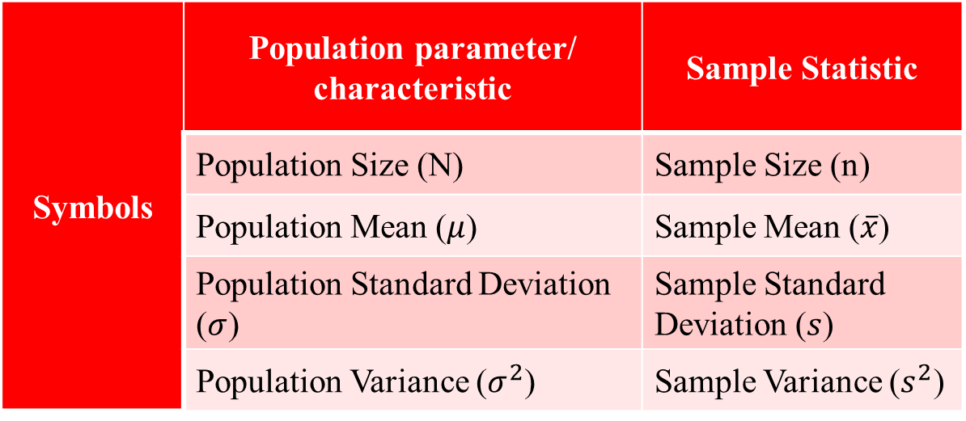
Test of Hypothesis (CO5)
Symbols for Population & Samples:
Symbols | Population parameter/ characteristic | Sample Statistic
 | Population Size (N) | Sample Size (n)
 | Population Mean ($μ$) | Sample Mean ($\overline{x}$)
 | Population Standard Deviation ($σ$) | Sample Standard Deviation ($s$)
 | Population Variance ($σ^{2}$) | Sample Variance ($s^{2}$)

Slide 13
Test of Hypothesis (CO5)
Procedure of Test of hypothesis
State Null hypothesis & Alternate hypothesis
Define level of significance
Use suitable test statistics
Establish critical region (Table value)
Conclusion

Slide 14
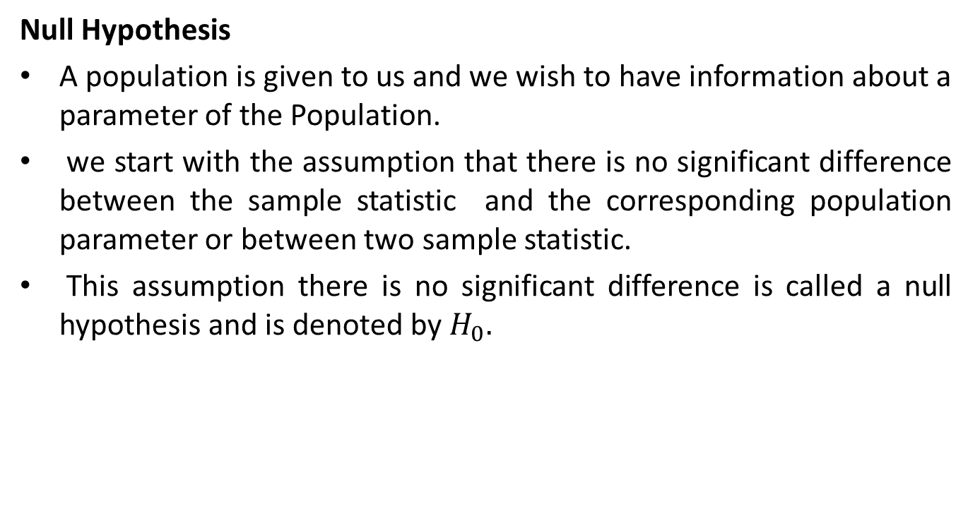
Test of Hypothesis (CO5)
Null Hypothesis
A population is given to us and we wish to have information about a parameter of the Population.
we start with the assumption that there is no significant difference between the sample statistic and the corresponding population parameter or between two sample statistic.
This assumption there is no significant difference is called a null hypothesis and is denoted by $H_{0}.$

Slide 15
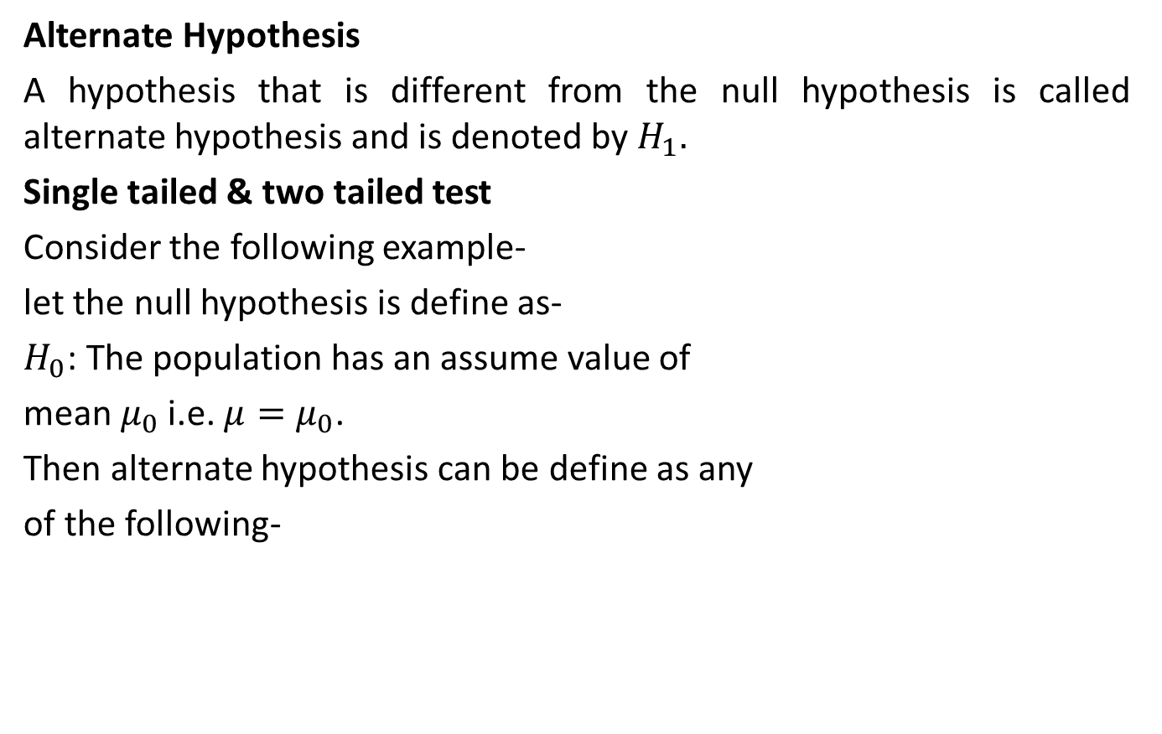
Test of Hypothesis (CO5)
Alternate Hypothesis
A hypothesis that is different from the null hypothesis is called alternate hypothesis and is denoted by $H_{1}.$
Single tailed & two tailed test
Consider the following example-
let the null hypothesis is define as-
$H_{0}$: The population has an assume value of
mean $μ_{0}$ i.e. $μ=μ_{0}$.
Then alternate hypothesis can be define as any
of the following-

Slide 16
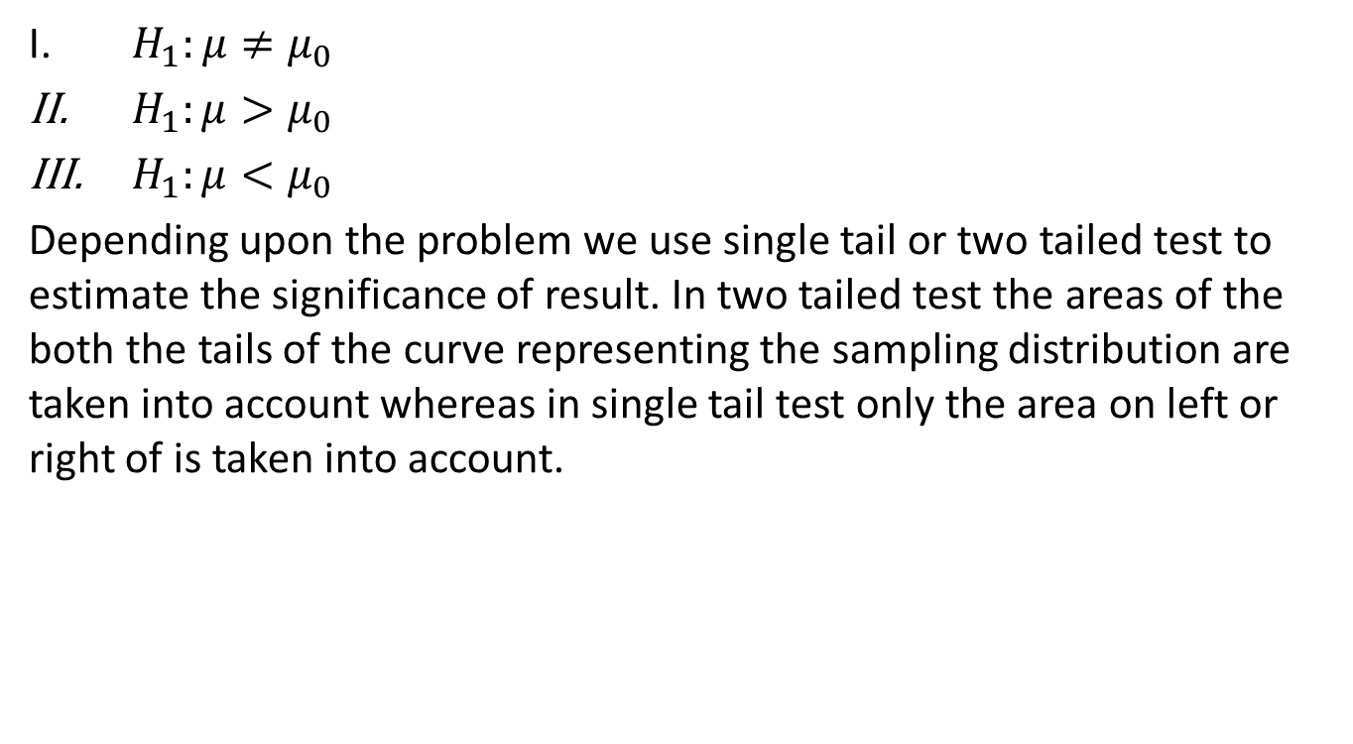
Test of Hypothesis (CO5)
$H_{1}:μ≠μ_{0}$
${ H}_{1}:μ>μ_{0}$
${ H}_{1}:μ<μ_{0}$
Depending upon the problem we use single tail or two tailed test to estimate the significance of result. In two tailed test the areas of the both the tails of the curve representing the sampling distribution are taken into account whereas in single tail test only the area on left or right of is taken into account.

Slide 17
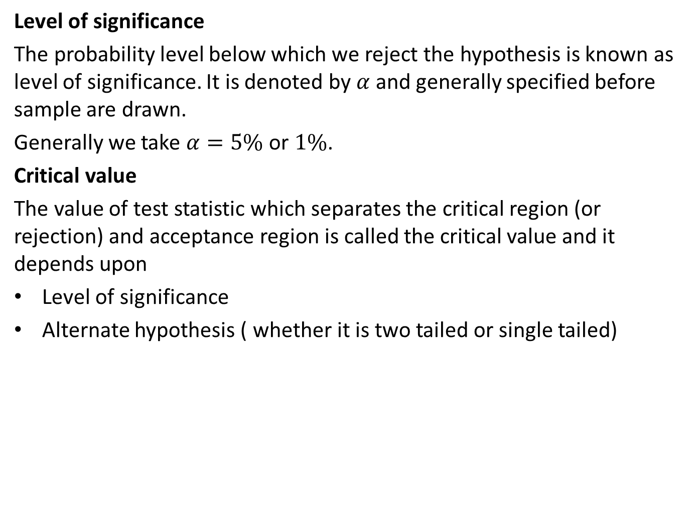
Test of Hypothesis (CO5)
Level of significance
The probability level below which we reject the hypothesis is known as level of significance. It is denoted by $α$ and generally specified before sample are drawn.
Generally we take $α=5\%$ or $1\%$.
Critical value
The value of test statistic which separates the critical region (or rejection) and acceptance region is called the critical value and it depends upon
Level of significance
Alternate hypothesis ( whether it is two tailed or single tailed)

Slide 18
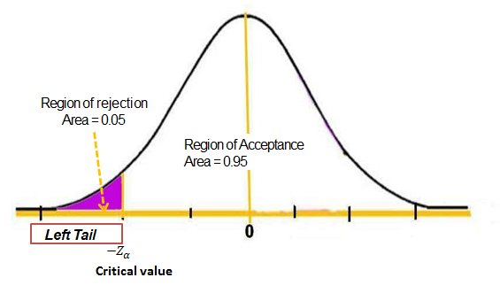

Test of Hypothesis (CO5)
Critical Region or rejection region
Critical region is the region in which a sample value is rejected.
Single left tailed test $α=5\%$ :

Slide 19
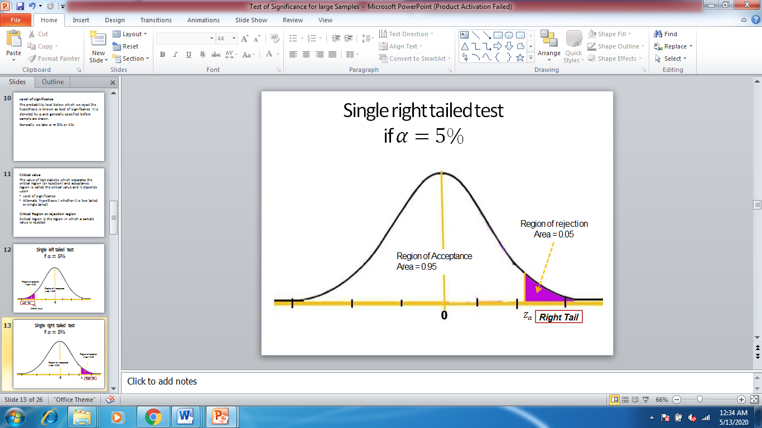
Test of Hypothesis (CO5)

Slide 20
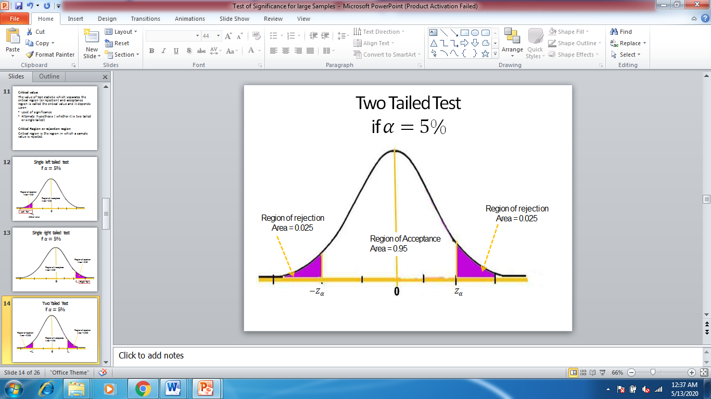
Test of Hypothesis (CO5)

Slide 21

Test of Hypothesis (CO5)
Conclusion
If absolute calculated value of test statistic is less than or equal to its critical value(table value), we accept the null hypothesis $H_{0}$ otherwise reject it.

Slide 22
Test of Hypothesis (CO5)
Test of hypothesis for large samples and Small samples
Difference between Large and Small sample
Sr. No. | Large Sample | Small Sample
1 | The sample size is greater than 30. | The sample size is less than or equal to 30.
2 | The value of statistic obtain from the sample can be taken as an estimate of population parameter. | The value of statistic obtain from the sample can not be taken as an estimate of population parameter.
3 | Normal distribution (z-test) is used for testing. | Sampling distribution like t, F etc. are used for testing.

Slide 23
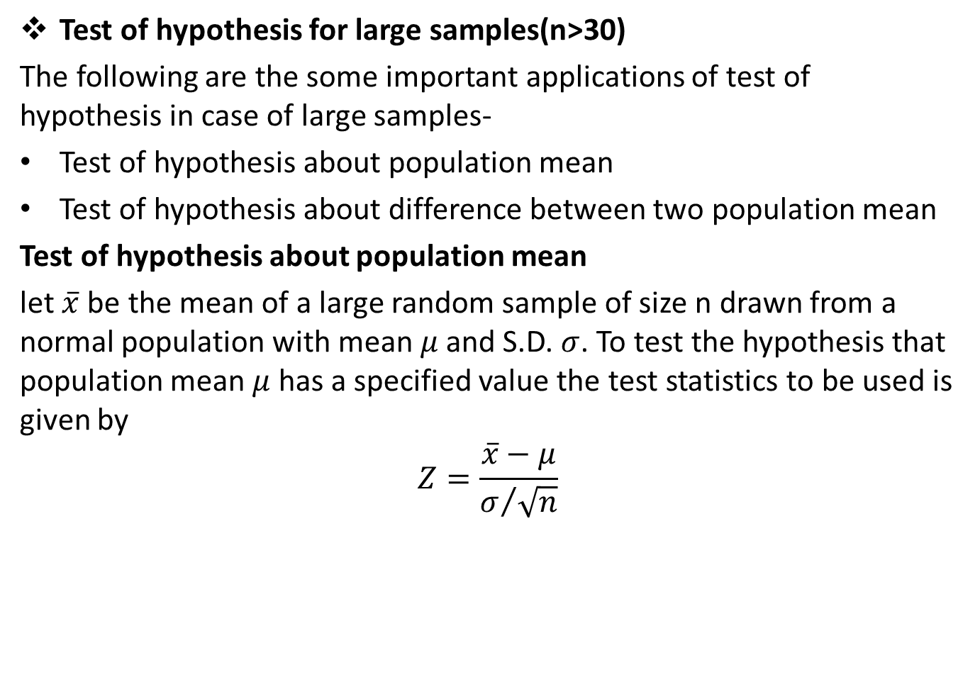
Test of Hypothesis (CO5)
Test of hypothesis for large samples(n>30)
The following are the some important applications of test of hypothesis in case of large samples-
Test of hypothesis about population mean
Test of hypothesis about difference between two population mean
Test of hypothesis about population mean
let $\overline{x}$ be the mean of a large random sample of size n drawn from a normal population with mean $μ$ and S.D. $σ$. To test the hypothesis that population mean $μ$ has a specified value the test statistics to be used is given by
$$Z=\frac{\overline{x}−μ}{σ/{\sqrt{n}}}$$

Slide 24
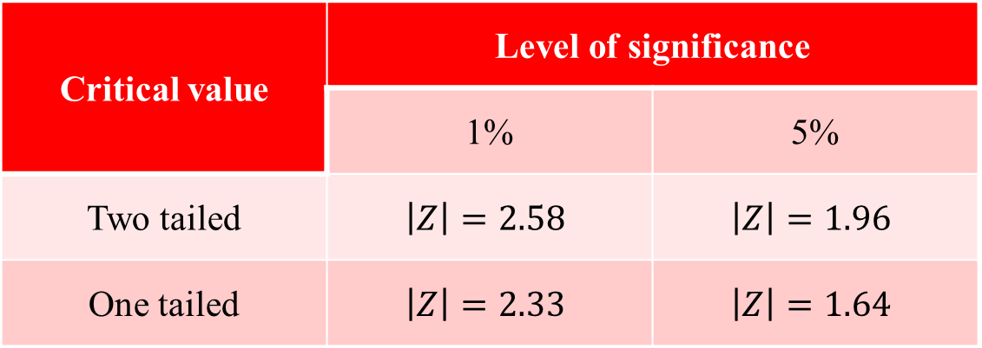

Test of Hypothesis (CO5)
For large sample $σ≅s$
Critical value | Level of significance
 | 1% | 5%
Two tailed | $$\left|Z\right|=2.58$$ | $$\left|Z\right|=1.96$$
One tailed | $$\left|Z\right|=2.33$$ | $$\left|Z\right|=1.64$$

Slide 25
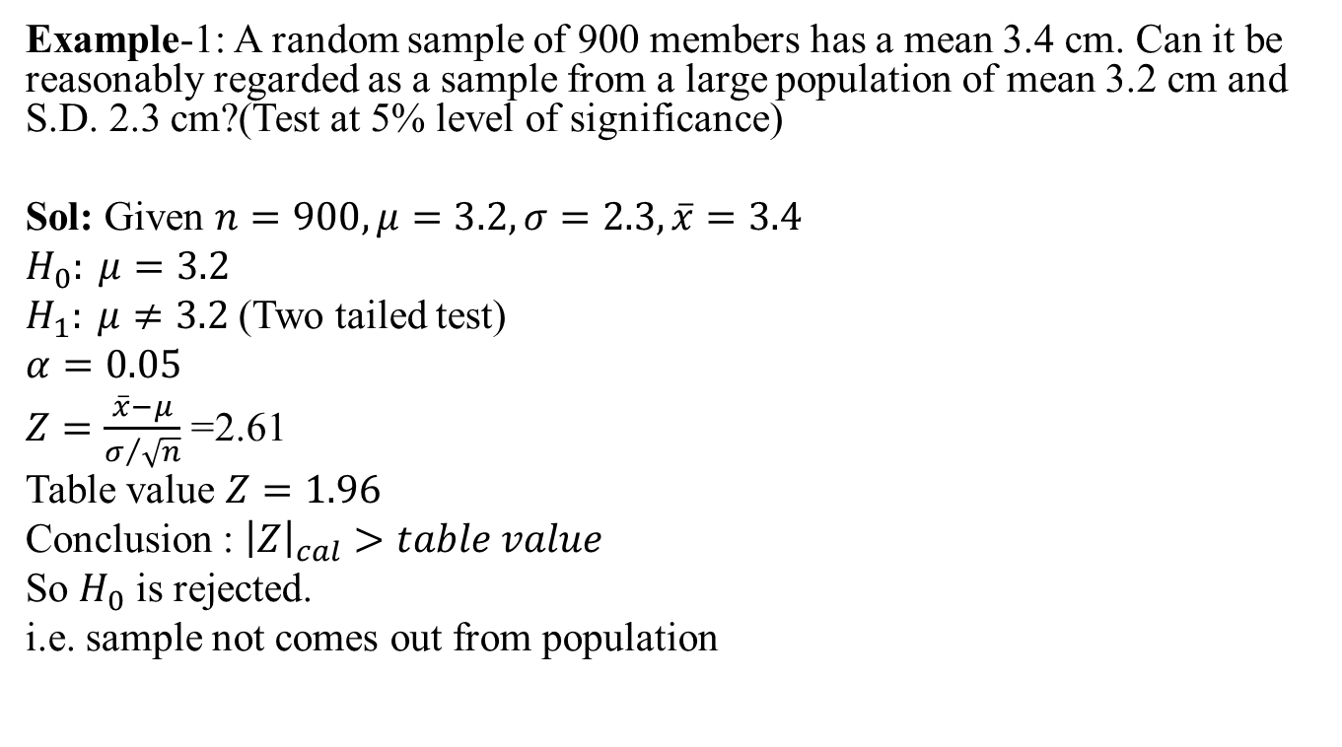
Test of Hypothesis (CO5)
Example-1: A random sample of 900 members has a mean 3.4 cm. Can it be reasonably regarded as a sample from a large population of mean 3.2 cm and S.D. 2.3 cm?(Test at 5% level of significance)
Sol: Given $n=900, μ=3.2, σ=2.3,\overline{x}=3.4$
$$H_{0}: μ=3.2$$
$H_{1}: μ≠3.2$(Two tailed test)
$$α=0.05$$
$Z=\frac{\overline{x}−μ}{σ/{\sqrt{n}}}$ =2.61
Table value $Z=1.96$
Conclusion : ${\left|Z\right|}_{cal}>table value$
So $H_{0}$ is rejected.
i.e. sample not comes out from population

Slide 26
Test of Hypothesis (CO5)
Example-2: An insurance agent has claimed that the avg. age of policy holders who insure through him is less then the avg. age of all agents which is 30.5 yrs.
A random sample of 100 policy holders who had insured through him gave the following age distribution-
Calculate arithmetic mean and standard deviation(S.D.) of this distribution and test his claim at 5% level of significance.
Age | 16-20 | 21-25 | 26-30 | 31-35 | 36-40
No. of person | 12 | 22 | 20 | 30 | 16

Slide 27
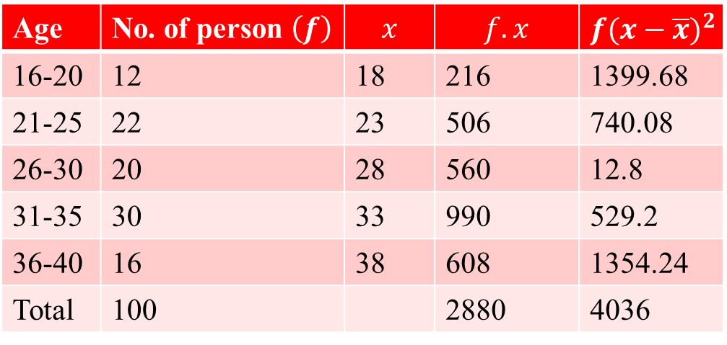

Test of Hypothesis (CO5)
Sol:
$$\overline{x}=\frac{\sum{f_{i}x_{i}}}{N}=\frac{2880}{100}=28.8; s=\sqrt{\frac{\sum{f_{i}{\left(x_{i}−\overline{x}\right)}^{2}}}{N}}=6.352$$
Age | No. of person $\left(f\right)$ | $$x$$ | $$f.x$$ | $$f{(x−\overline{x})}^{2}$$
16-20 | 12 | 18 | 216 | 1399.68
21-25 | 22 | 23 | 506 | 740.08
26-30 | 20 | 28 | 560 | 12.8
31-35 | 30 | 33 | 990 | 529.2
36-40 | 16 | 38 | 608 | 1354.24
Total | 100 |  | 2880 | 4036

Slide 28
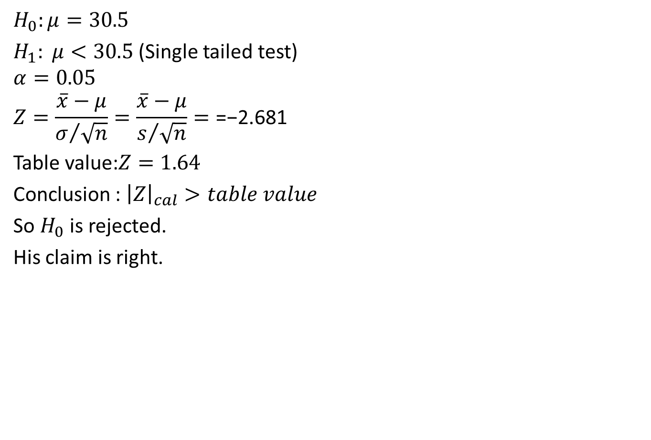
Test of Hypothesis (CO5)
$$H_{0}:μ=30.5$$
$H_{1}: μ<30.5$ (Single tailed test)
$$α=0.05$$
$$Z=\frac{\overline{x}−μ}{σ/{\sqrt{n}}}=\frac{\overline{x}−μ}{s/{\sqrt{n}}}=\text{=−2.681}$$
Table value:$Z=1.64$
Conclusion : ${\left|Z\right|}_{cal}>table value$
So $H_{0}$ is rejected.
His claim is right.

Slide 29
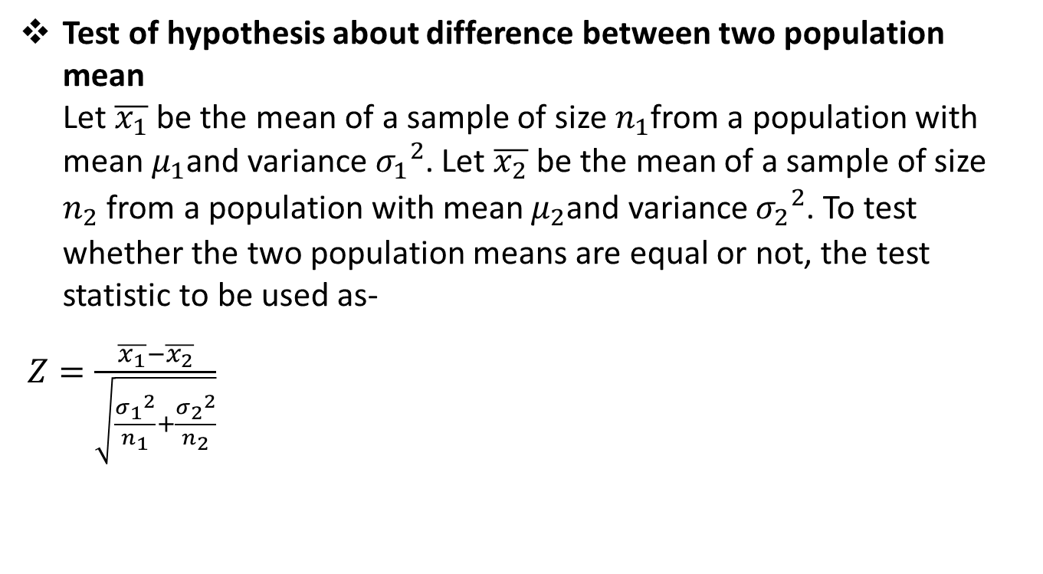
Test of Hypothesis (CO5)
Test of hypothesis about difference between two population mean Let $\overline{x_{1}}$ be the mean of a sample of size $n_{1}$from a population with mean $μ_{1}$and variance ${σ_{1}}_{ }^{2}$. Let $\overline{x_{2}}$ be the mean of a sample of size $n_{2}$ from a population with mean $μ_{2}$and variance ${σ_{2}}_{ }^{2}$. To test whether the two population means are equal or not, the test statistic to be used as-
$Z=\frac{\overline{x_{1}}−\overline{x_{2}}}{\sqrt{\frac{{σ_{1}}_{ }^{2}}{n_{1}}+\frac{{σ_{2}}_{ }^{2}}{n_{2}}}}$

Slide 30
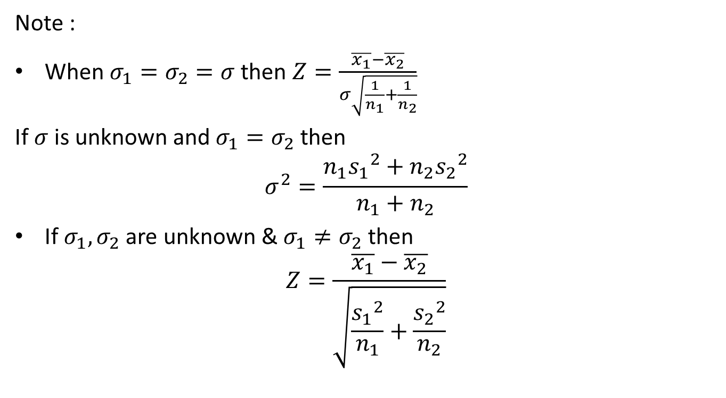
Test of Hypothesis (CO5)
Note :
When $σ_{1}=σ_{2}=σ$then $Z=\frac{\overline{x_{1}}−\overline{x_{2}}}{σ\sqrt{\frac{1}{n_{1}}+\frac{1}{n_{2}}}}$
If $σ$ is unknown and $σ_{1}=σ_{2}$ then
$$σ^{2}=\frac{n_{1}{s_{1}}_{ }^{2}+n_{2}{s_{2}}_{ }^{2}}{n_{1}+n_{2}}$$
If $σ_{1},σ_{2}$ are unknown & $σ_{1}≠σ_{2}$ then
$$Z=\frac{\overline{x_{1}}−\overline{x_{2}}}{\sqrt{\frac{{s_{1}}_{ }^{2}}{n_{1}}+\frac{{s_{2}}_{ }^{2}}{n_{2}}}}$$

Slide 31
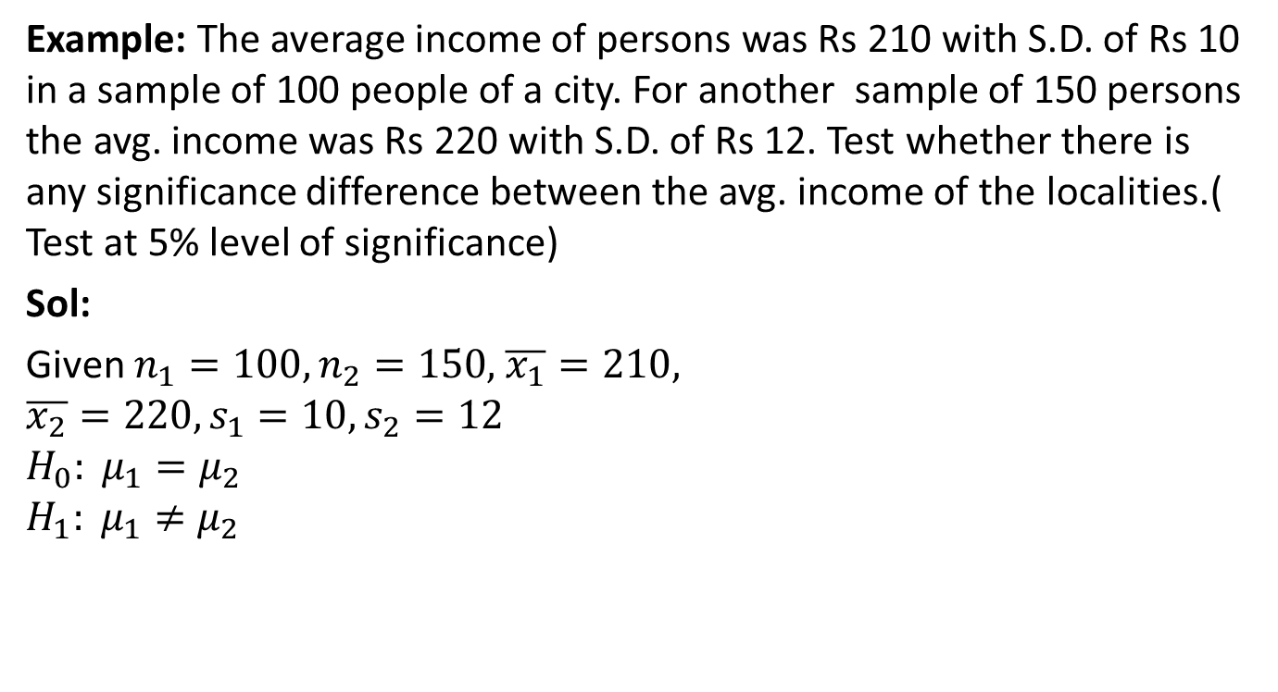
Test of Hypothesis (CO5)
Example: The average income of persons was Rs 210 with S.D. of Rs 10 in a sample of 100 people of a city. For another sample of 150 persons the avg. income was Rs 220 with S.D. of Rs 12. Test whether there is any significance difference between the avg. income of the localities.( Test at 5% level of significance)
Sol:
Given $n_{1}=100,n_{2}=150,$ $\overline{x_{1}}=210,$
$$\overline{x_{2}}=220, s_{1}=10,s_{2}=12$$
$$H_{0}: μ_{1}=μ_{2}$$
$$H_{1}: μ_{1}≠μ_{2}$$

Slide 32
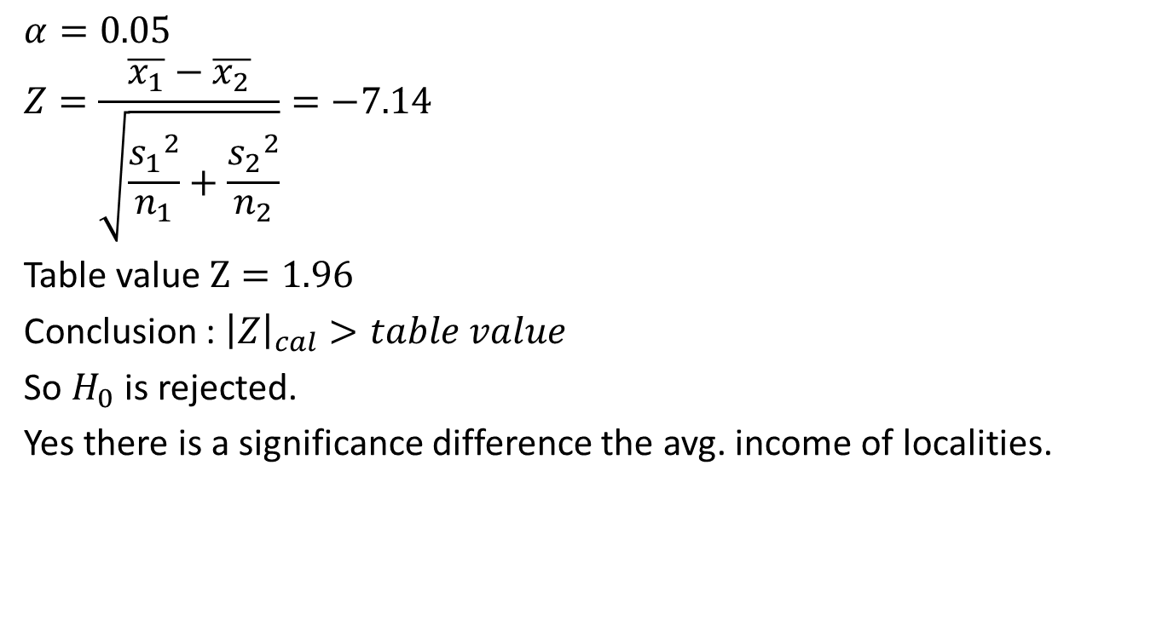
Test of Hypothesis (CO5)
$$α=0.05$$
$$Z=\frac{\overline{x_{1}}−\overline{x_{2}}}{\sqrt{\frac{{s_{1}}_{ }^{2}}{n_{1}}+\frac{{s_{2}}_{ }^{2}}{n_{2}}}}=−7.14$$
Table value $Z=1.96$
Conclusion : ${\left|Z\right|}_{cal}>table value$
So $H_{0}$ is rejected.
Yes there is a significance difference the avg. income of localities.

Slide 33
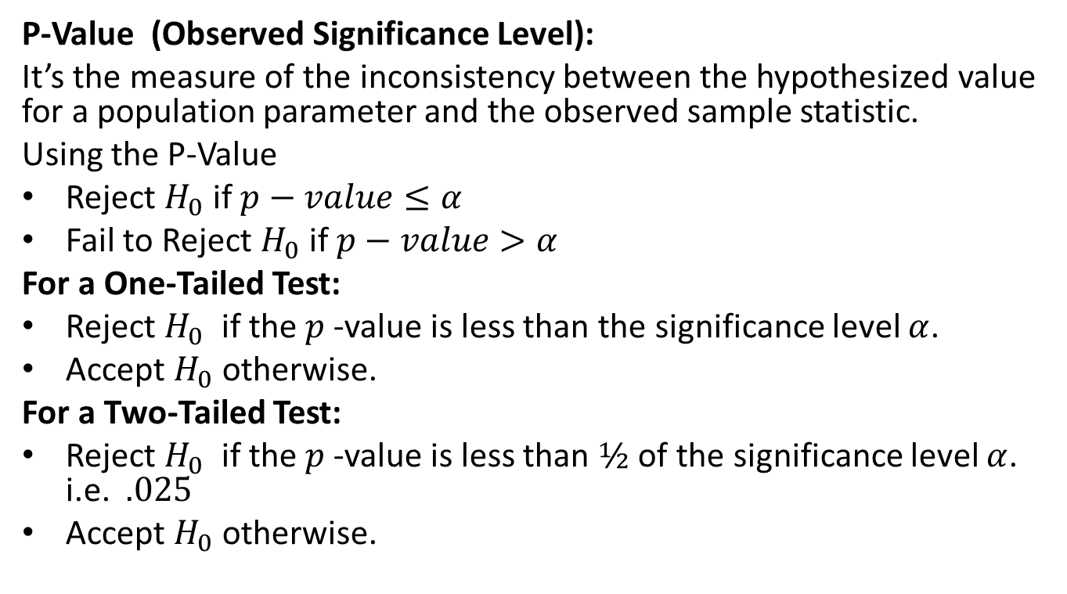
P-value (CO5)
P-Value (Observed Significance Level):
It’s the measure of the inconsistency between the hypothesized value for a population parameter and the observed sample statistic.
Using the P-Value
Reject $H_{0}$ if $p−value≤α$
Fail to Reject $H_{0}$ if $p−value>α$
For a One-Tailed Test:
Reject $H_{0}$ if the $p$-value is less than the significance level $α$.
Accept $H_{0}$ otherwise.
For a Two-Tailed Test:
Reject $H_{0}$ if the $p$-value is less than $½$ of the significance level $α$. i.e. $.025$
Accept $H_{0}$ otherwise.

Slide 34
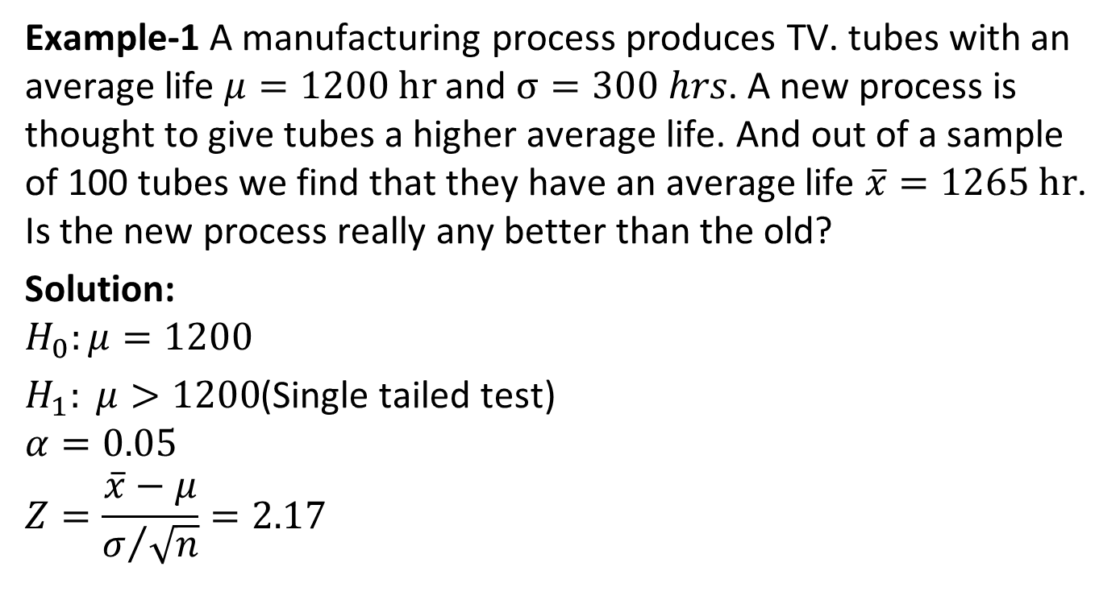
P-value (CO5)
Example-1 A manufacturing process produces TV. tubes with an average life $μ=1200 hr$ and $σ=300 hrs$. A new process is thought to give tubes a higher average life. And out of a sample of 100 tubes we find that they have an average life $\overline{x}=1265 hr$. Is the new process really any better than the old?
Solution:
$$H_{0}:μ=1200$$
$H_{1}: μ>1200$(Single tailed test)
$$α=0.05$$
$$Z=\frac{\overline{x}−μ}{σ/{\sqrt{n}}}=2.17$$

Slide 35

P-value (CO5)
$$P\left(\overline{x}≥1265\right)=P\left(z≥2.17\right)=.015$$
Here we reject $H_{0}$
Since $p−value≤α=0.05$

Slide 36
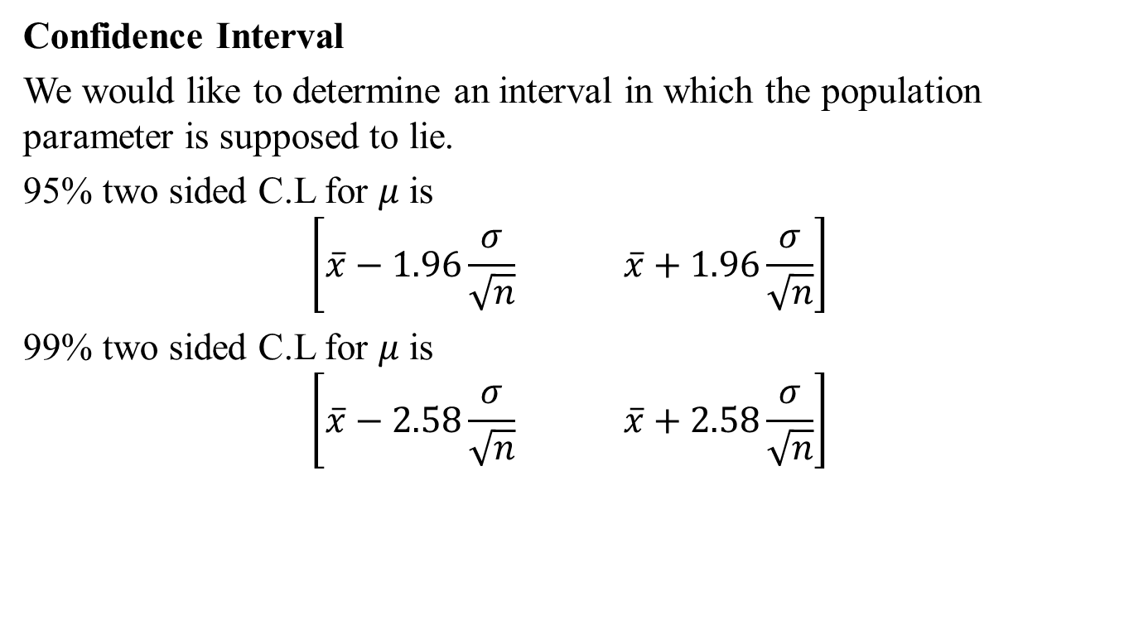
Test of Hypothesis (CO5)
Confidence Interval
We would like to determine an interval in which the population parameter is supposed to lie.
95% two sided C.L for $μ$is
$$\left[\overline{x}−1.96\frac{σ}{\sqrt{n}} \overline{x}+1.96\frac{σ}{\sqrt{n}}\right]$$
99% two sided C.L for $μ$is
$$\left[\overline{x}−2.58\frac{σ}{\sqrt{n}} \overline{x}+2.58\frac{σ}{\sqrt{n}}\right]$$

Slide 37
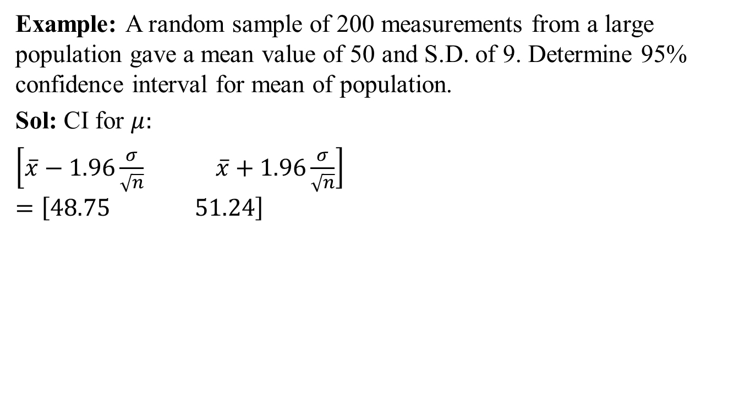
Test of Hypothesis (CO5)
Example: A random sample of 200 measurements from a large population gave a mean value of 50 and S.D. of 9. Determine 95% confidence interval for mean of population.
Sol: CI for $μ:$
$\left[\overline{x}−1.96\frac{σ}{\sqrt{n}} \overline{x}+1.96\frac{σ}{\sqrt{n}}\right]$
$$=\left[48.75 51.24\right]$$

Slide 38
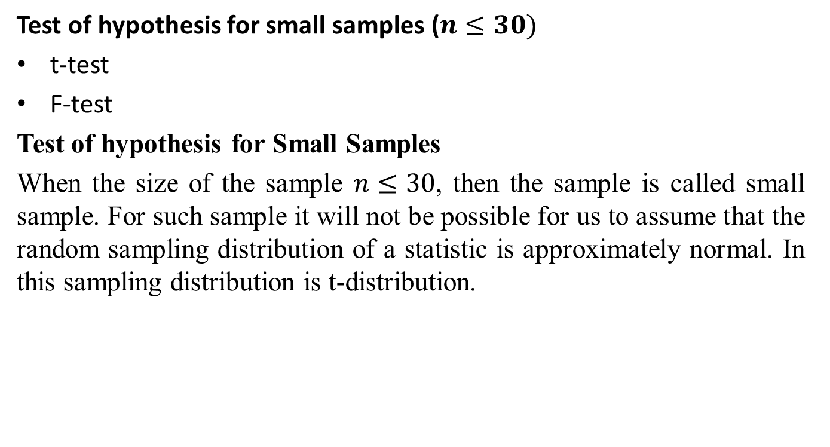
Test of Hypothesis (CO5)
Test of hypothesis for small samples ($n≤30)$
t-test
F-test
Test of hypothesis for Small Samples
When the size of the sample $n≤30$, then the sample is called small sample. For such sample it will not be possible for us to assume that the random sampling distribution of a statistic is approximately normal. In this sampling distribution is t-distribution.

Slide 39

Daily Quiz(CO5)
Write a short note on Null hypothesis?
Write a short note on Alternative hypothesis?
A sample of 800 students from a university was taken and their average weight was found to be 112 pounds with S.D. of 20 pounds. Could the mean weight in the population be 120 pounds.(Take $α=0.05)$

Slide 40
Recap(CO5)
Test of hypothesis
Procedure of Test of hypothesis
Null Hypothesis
Alternate Hypothesis
Level of significance
Test of hypothesis about difference between two population mean
Test of hypothesis about Small samples

Slide 41
Topic objective (CO5)
t-Test
Explanation why a t distribution is associated with n − 1 degrees of freedom and describe the information that is conveyed by the t statistic.
Calculation the degrees of freedom for a one-sample t test and a two-independent-sample t test, and locate critical values in the t table.
Identify the assumptions for the one-sample t test.
Identify the assumptions for the two-independent-sample t test.

Slide 42
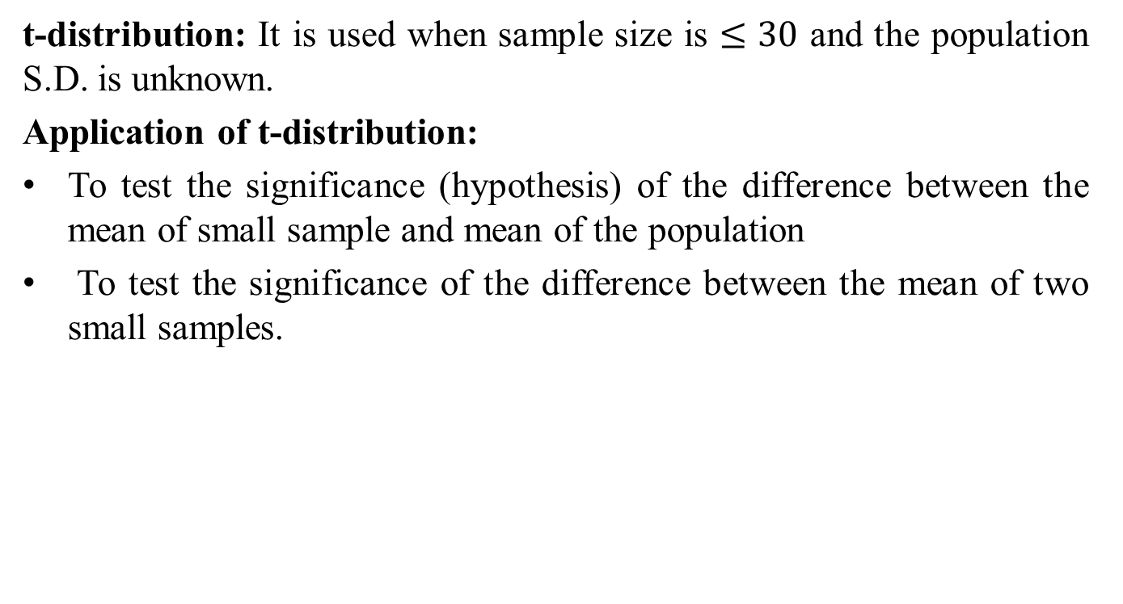
t-Test (CO5)
t-distribution: It is used when sample size is $≤30$ and the population S.D. is unknown.
Application of t-distribution:
To test the significance (hypothesis) of the difference between the mean of small sample and mean of the population
To test the significance of the difference between the mean of two small samples.

Slide 43
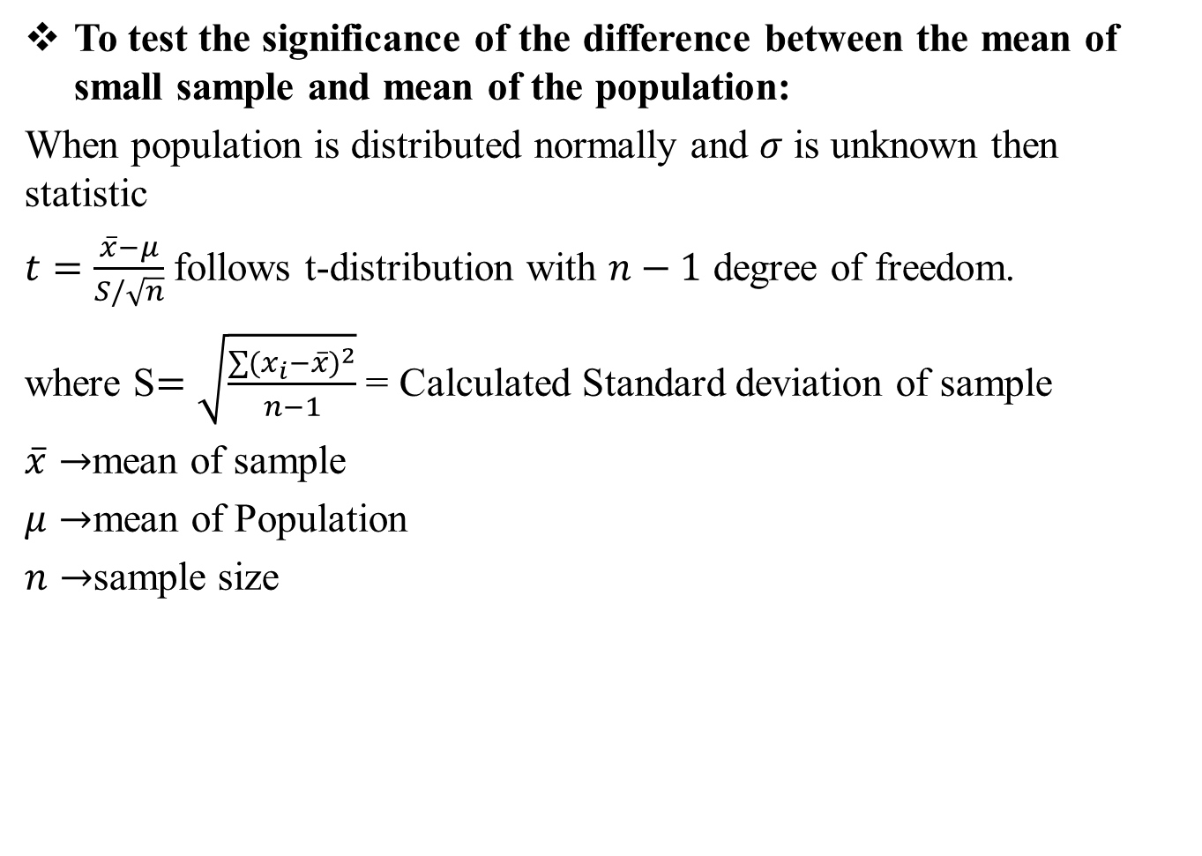
t-Test (CO5)
To test the significance of the difference between the mean of small sample and mean of the population:
When population is distributed normally and $σ$ is unknown then statistic
$t=\frac{\overline{x}−μ}{S/\sqrt{n}}$ follows t-distribution with $n−1$ degree of freedom.
where S$=\sqrt{\frac{\sum{{(x_{i}−\overline{x})}^{2}}}{n−1}}$ = Calculated Standard deviation of sample
$\overline{x}→$mean of sample
$μ→$mean of Population
$n→$sample size

Slide 44
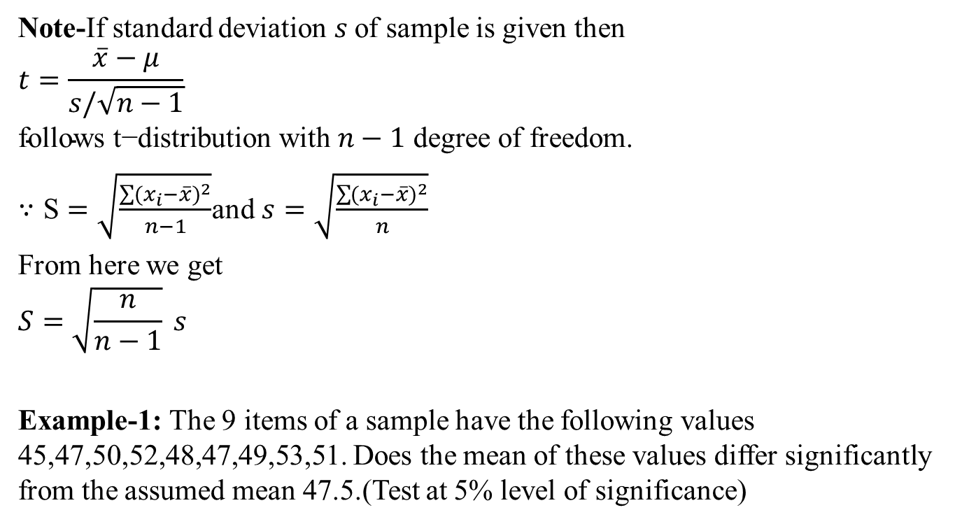
t-Test (CO5)
Note-If standard deviation $s$of sample is given then
$$t=\frac{\overline{x}−μ}{s/\sqrt{n−1}}$$
$$\text{follows} \text{t}\text{−}\text{distribution} \text{with} n−1 \text{degree} \text{of} \text{freedom}\text{.}$$
$∵\text{S}=\sqrt{\frac{\sum{{(x_{i}−\overline{x})}^{2}}}{n−1}}$and $s=\sqrt{\frac{\sum{{(x_{i}−\overline{x})}^{2}}}{n}}$
From here we get
$$S=\sqrt{\frac{n}{n−1}} s$$
Example-1: The 9 items of a sample have the following values 45,47,50,52,48,47,49,53,51. Does the mean of these values differ significantly from the assumed mean 47.5.(Test at 5% level of significance)

Slide 45
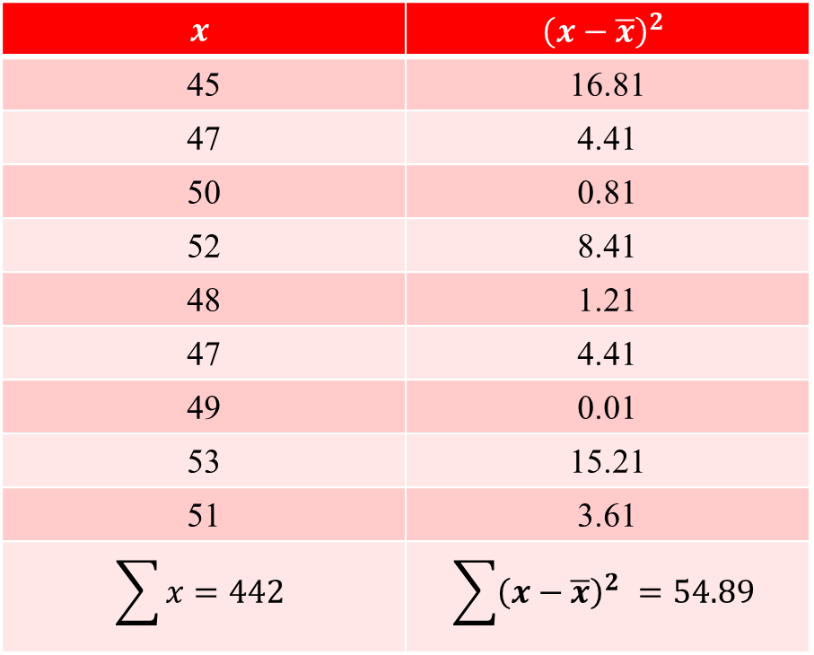
t-Test (CO5)
Sol: Here sample is small so we use t-test
$$x$$ | $${\left(x−\overline{x}\right)}^{2}$$
45 | 16.81
47 | 4.41
50 | 0.81
52 | 8.41
48 | 1.21
47 | 4.41
49 | 0.01
53 | 15.21
51 | 3.61
$$\sum{x}=442$$ | $$\sum{{\left(x−\overline{x}\right)}^{2} =54.89}$$

Slide 46
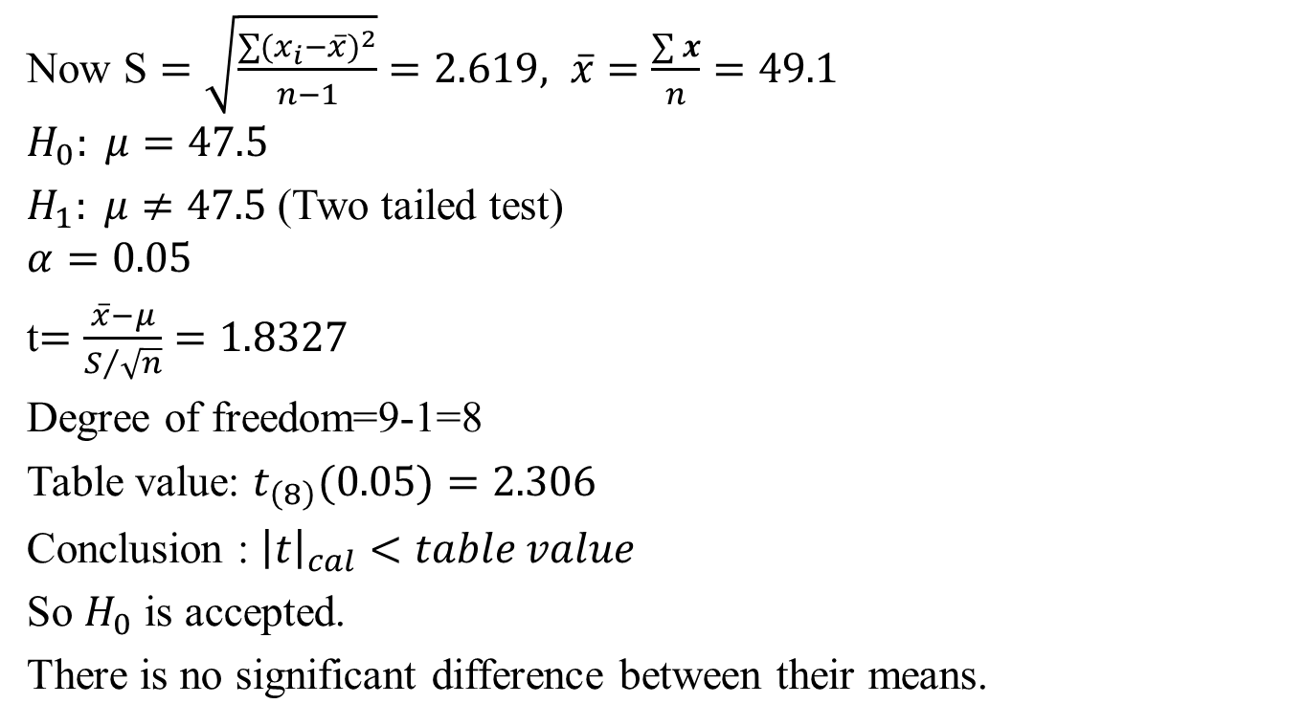
t-Test (CO5)
Now $\text{S}=\sqrt{\frac{\sum{{(x_{i}−\overline{x})}^{2}}}{n−1}}=2.619, \overline{x}=\frac{\sum{x}}{n}=49.1$
$$H_{0}: μ=47.5$$
$H_{1}: μ≠47.5$(Two tailed test)
$$α=0.05$$
t$=\frac{\overline{x}−μ}{S/{\sqrt{n}}}=1.8327$
Degree of freedom=9-1=8
Table value: $t_{\left(8\right)}(0.05)=2.306$
Conclusion : ${\left|t\right|}_{cal}<table value$
So $H_{0}$ is accepted.
There is no significant difference between their means.

Slide 47
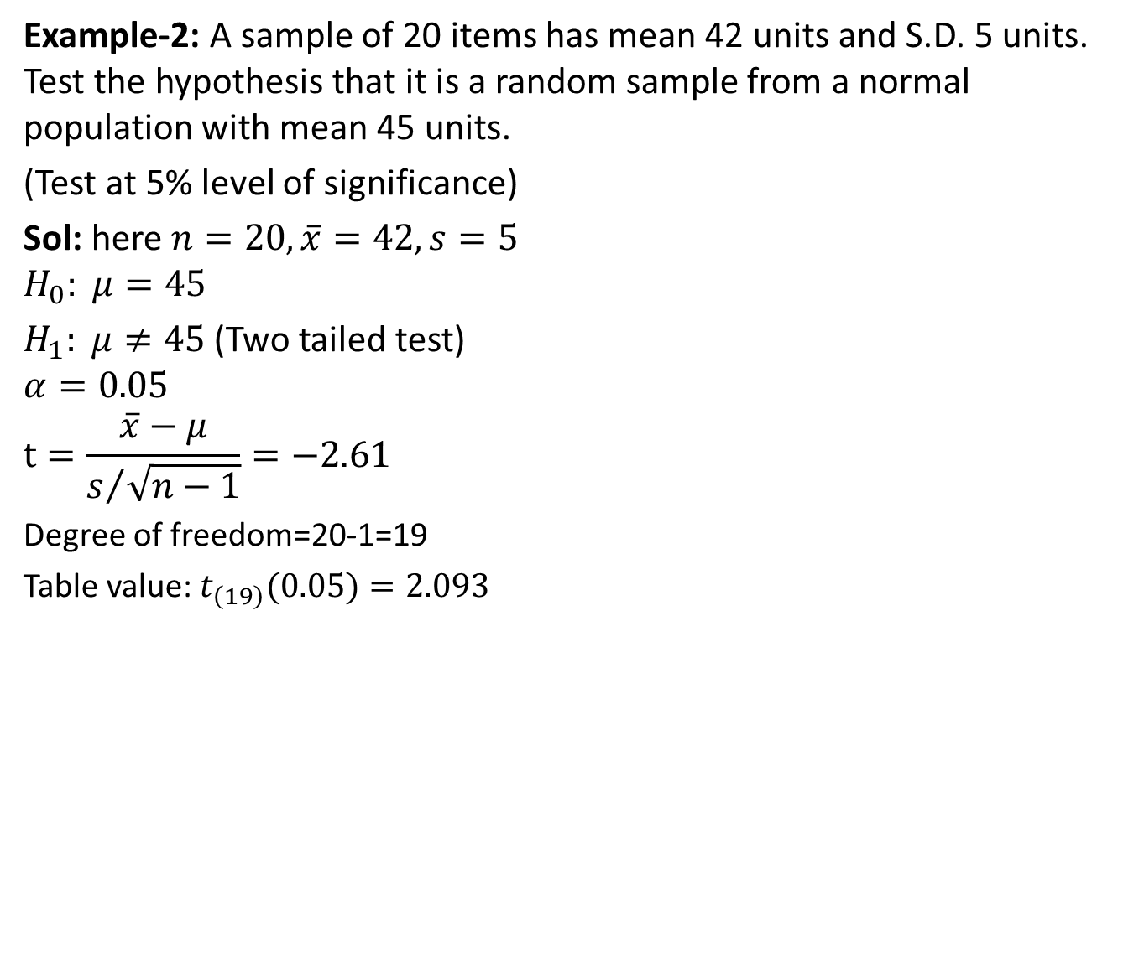
t-Test (CO5)
Example-2: A sample of 20 items has mean 42 units and S.D. 5 units. Test the hypothesis that it is a random sample from a normal population with mean 45 units.
(Test at 5% level of significance)
Sol: here $n=20, \overline{x}=42, s=5$
$$H_{0}: μ=45$$
$H_{1}: μ≠45$(Two tailed test)
$$α=0.05$$
$$t=\frac{\overline{x}−μ}{s/{\sqrt{n−1}}}=−2.61$$
Degree of freedom=20-1=19
Table value: $t_{\left(19\right)}(0.05)=2.093$

Slide 48
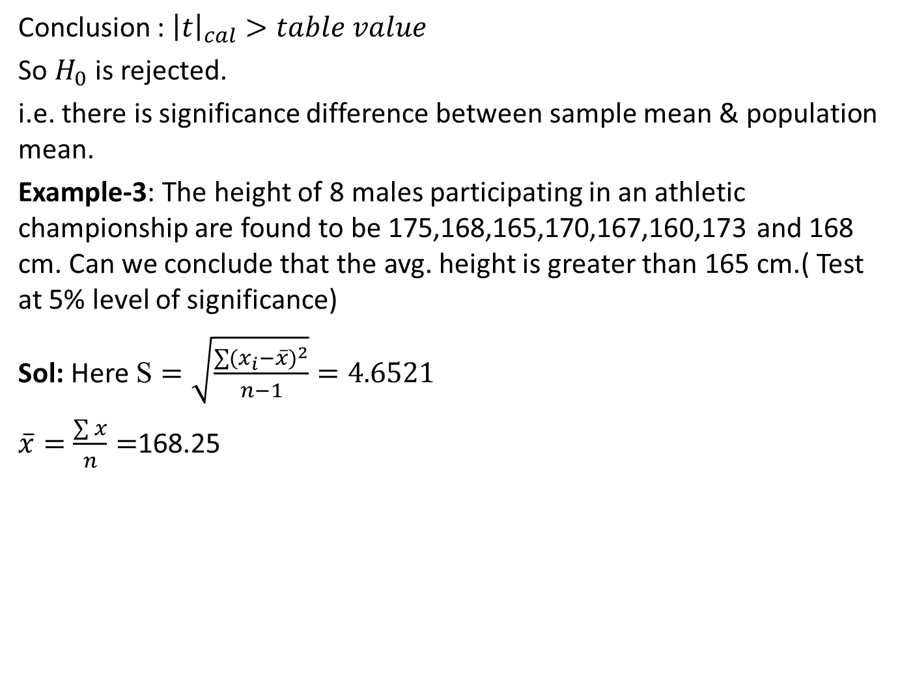
t-Test (CO5)
Conclusion : ${\left|t\right|}_{cal}>table value$
So $H_{0}$ is rejected.
i.e. there is significance difference between sample mean & population mean.
Example-3: The height of 8 males participating in an athletic championship are found to be 175,168,165,170,167,160,173 and 168 cm. Can we conclude that the avg. height is greater than 165 cm.( Test at 5% level of significance)
Sol: Here $\text{S}=\sqrt{\frac{\sum{{(x_{i}−\overline{x})}^{2}}}{n−1}}=4.6521$
$\overline{x}=\frac{\sum{x}}{n}=$168.25

Slide 49
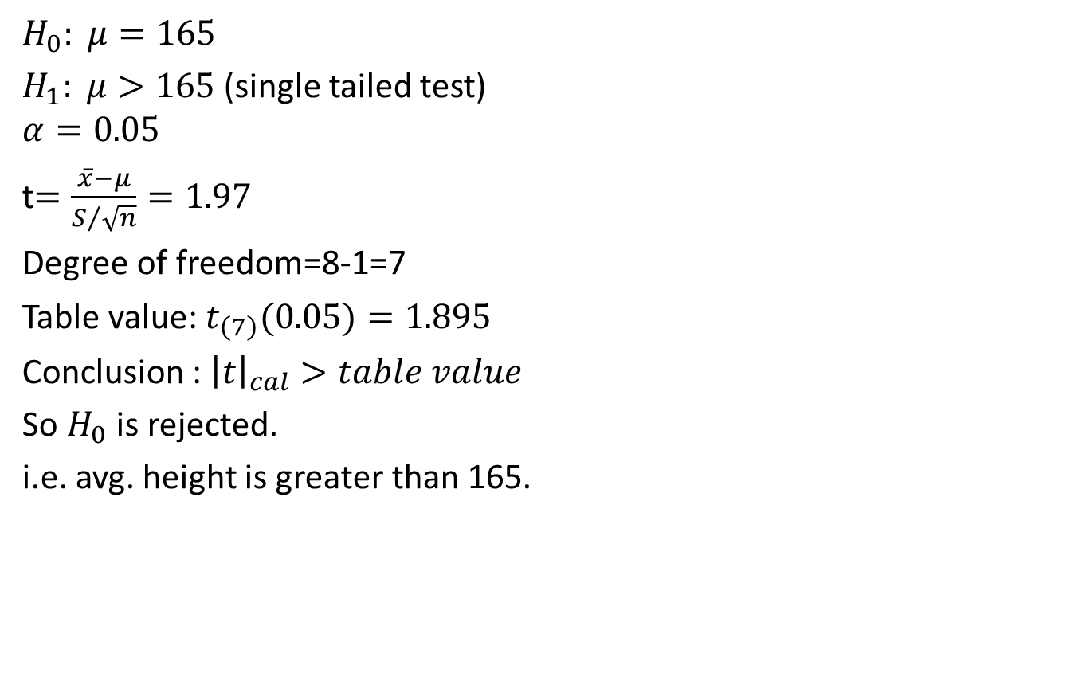
t-Test (CO5)
$$H_{0}: μ=165$$
$H_{1}: μ>165$(single tailed test)
$$α=0.05$$
t$=\frac{\overline{x}−μ}{S/{\sqrt{n}}}=1.97$
Degree of freedom=8-1=7
Table value: $t_{\left(7\right)}(0.05)=1.895$
Conclusion : ${\left|t\right|}_{cal}>table value$
So $H_{0}$ is rejected.
i.e. avg. height is greater than 165.

Slide 50
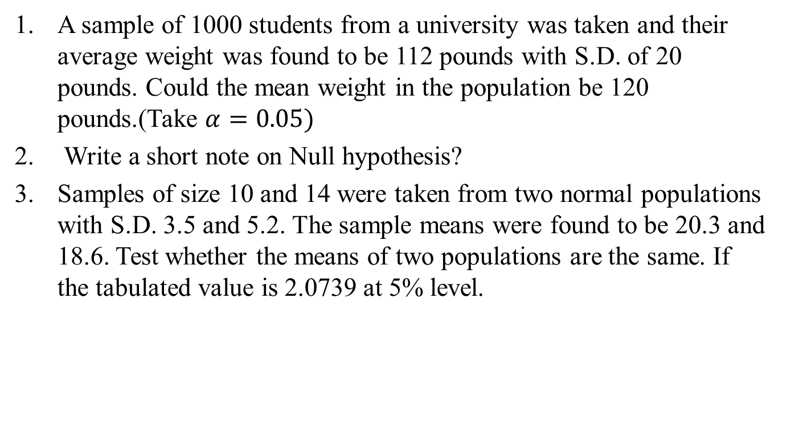
Daily Quiz(CO5)
A sample of 1000 students from a university was taken and their average weight was found to be 112 pounds with S.D. of 20 pounds. Could the mean weight in the population be 120 pounds.(Take $α=0.05)$
Write a short note on Null hypothesis?
Samples of size 10 and 14 were taken from two normal populations with S.D. 3.5 and 5.2. The sample means were found to be 20.3 and 18.6. Test whether the means of two populations are the same. If the tabulated value is 2.0739 at 5% level.

Slide 51
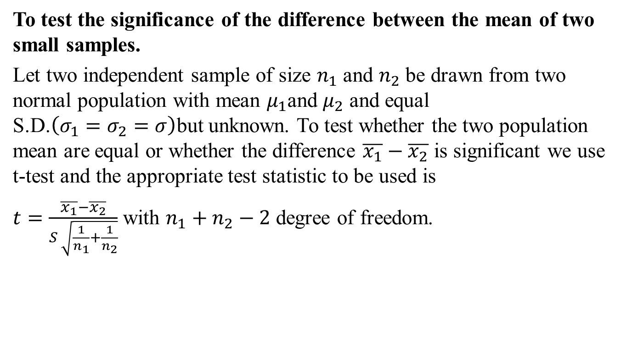
t-Test (CO5)
To test the significance of the difference between the mean of two small samples.
Let two independent sample of size $n_{1}$ and $n_{2}$ be drawn from two normal population with mean $μ_{1}$and $μ_{2}$ and equal S.D.$\left(σ_{1}=σ_{2}=σ\right)$but unknown. To test whether the two population mean are equal or whether the difference $\overline{x_{1}}−\overline{x_{2}}$ is significant we use t-test and the appropriate test statistic to be used is
$t=\frac{\overline{x_{1}}−\overline{x_{2}}}{S \sqrt{\frac{1}{n_{1}}+\frac{1}{n_{2}}}}$ with $n_{1}+n_{2}−2$ degree of freedom.

Slide 52
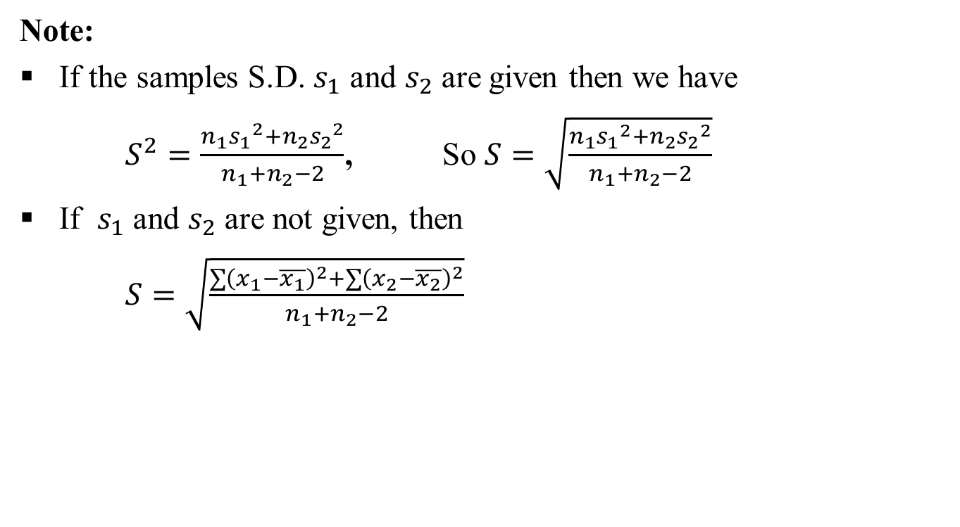
t-Test (CO5)
Note:
If the samples S.D. $s_{1}$ and $s_{2}$ are given then we have
$S^{2}=\frac{n_{1}{s_{1}}_{ }^{2}+n_{2}{s_{2}}_{ }^{2}}{n_{1}+n_{2}−2}$, So $S=\sqrt{\frac{n_{1}{s_{1}}_{ }^{2}+n_{2}{s_{2}}_{ }^{2}}{n_{1}+n_{2}−2}}$
If $s_{1}$ and $s_{2}$ are not given, then
$S=\sqrt{\frac{\sum{{\left(x_{1}−\overline{x_{1}}\right)}^{2}}+\sum{{\left(x_{2}−\overline{x_{2}}\right)}^{2}}}{n_{1}+n_{2}−2}}$

Slide 53
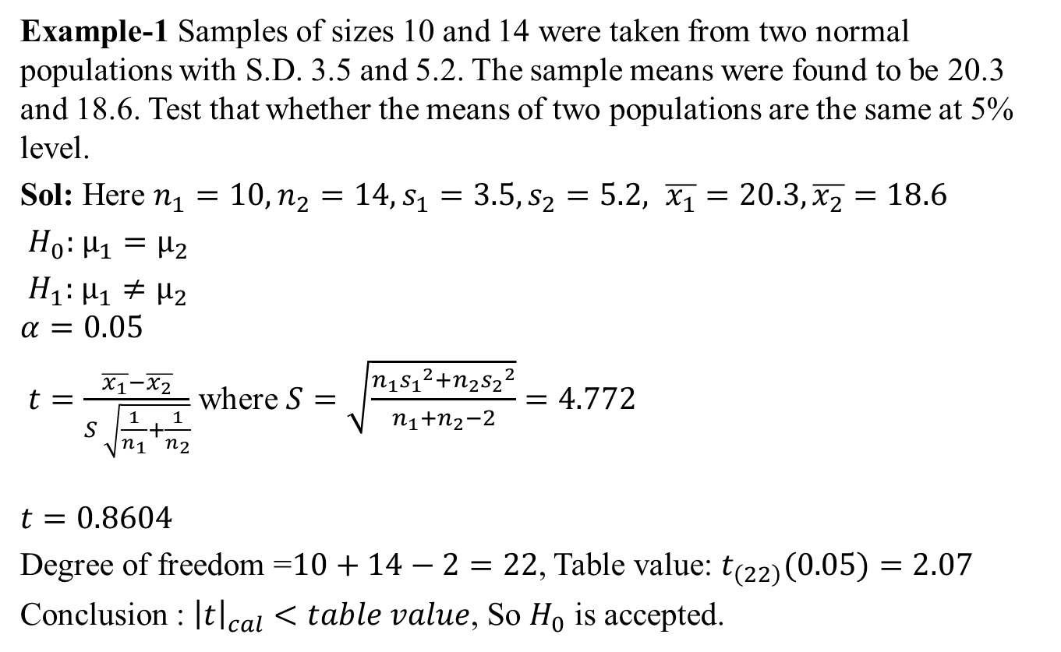
t-Test (CO5)
Example-1 Samples of sizes 10 and 14 were taken from two normal populations with S.D. 3.5 and 5.2. The sample means were found to be 20.3 and 18.6. Test that whether the means of two populations are the same at 5% level.
Sol: Here $n_{1}=10,n_{2}=14,s_{1}=3.5,s_{2}=5.2, \overline{x_{1}}=20.3,\overline{x_{2}}=18.6$
$H_{0}:$ $μ_{1}=μ_{2}$
$H_{1}:$ $μ_{1}≠μ_{2}$
$$α=0.05$$
$t=\frac{\overline{x_{1}}−\overline{x_{2}}}{S \sqrt{\frac{1}{n_{1}}+\frac{1}{n_{2}}}}$ where $S=\sqrt{\frac{n_{1}{s_{1}}_{ }^{2}+n_{2}{s_{2}}_{ }^{2}}{n_{1}+n_{2}−2}}=4.772$
$$t=0.8604$$
Degree of freedom =$10+14−2=22$, Table value: $t_{\left(22\right)}(0.05)=2.07$
Conclusion : ${\left|t\right|}_{cal}<table value$, So $H_{0}$ is accepted.

Slide 54
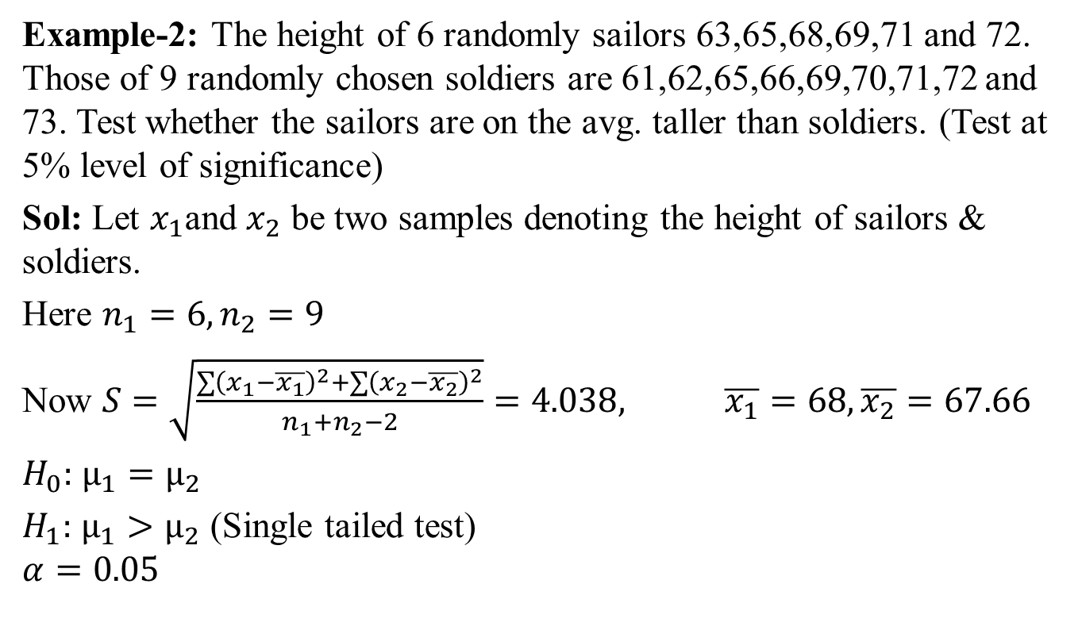
t-Test (CO5)
Example-2: The height of 6 randomly sailors 63,65,68,69,71 and 72. Those of 9 randomly chosen soldiers are 61,62,65,66,69,70,71,72 and 73. Test whether the sailors are on the avg. taller than soldiers. (Test at 5% level of significance)
Sol: Let $x_{1}$and $x_{2}$ be two samples denoting the height of sailors & soldiers.
Here $n_{1}=6,n_{2}=9$
Now $S=\sqrt{\frac{\sum{{\left(x_{1}−\overline{x_{1}}\right)}^{2}}+\sum{{\left(x_{2}−\overline{x_{2}}\right)}^{2}}}{n_{1}+n_{2}−2}}=4.038, \overline{x_{1}}=68,\overline{x_{2}}=67.66$
$H_{0}:$ $μ_{1}=μ_{2}$
$H_{1}:$ $μ_{1}>μ_{2}$ (Single tailed test)
$$α=0.05$$

Slide 55
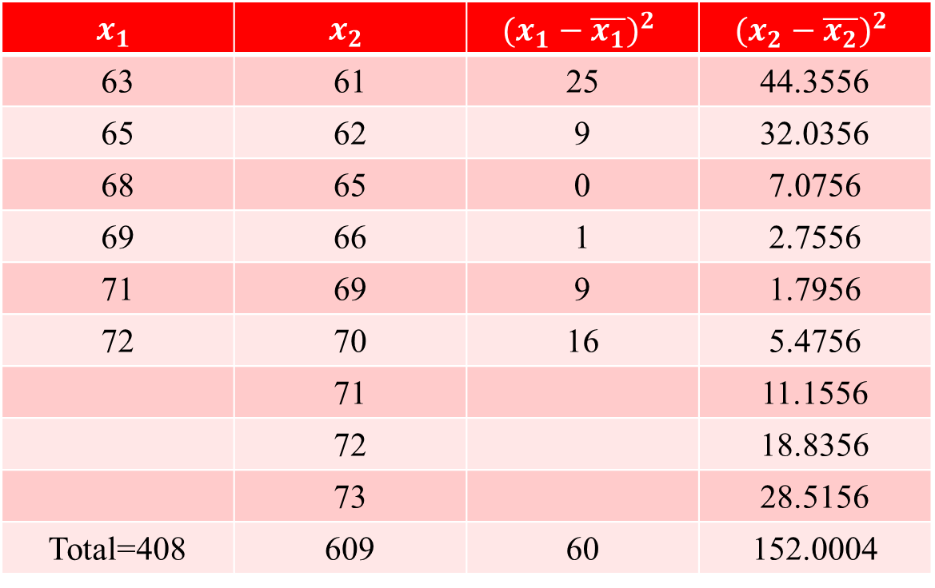
t-Test (CO5)
$$x_{1}$$ | $$x_{2}$$ | $${(x_{1}−\overline{x_{1}})}^{2}$$ | $${(x_{2}−\overline{x_{2}})}^{2}$$
63 | 61 | 25 | 44.3556
65 | 62 | 9 | 32.0356
68 | 65 | 0 | 7.0756
69 | 66 | 1 | 2.7556
71 | 69 | 9 | 1.7956
72 | 70 | 16 | 5.4756
 | 71 |  | 11.1556
 | 72 |  | 18.8356
 | 73 |  | 28.5156
Total=408 | 609 | 60 | 152.0004

Slide 56
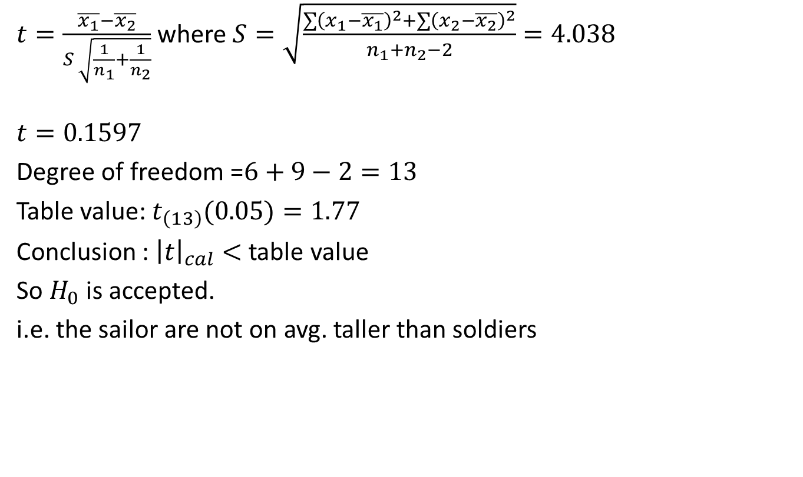
t-Test (CO5)
$t=\frac{\overline{x_{1}}−\overline{x_{2}}}{S \sqrt{\frac{1}{n_{1}}+\frac{1}{n_{2}}}}$ where$S=\sqrt{\frac{\sum{{\left(x_{1}−\overline{x_{1}}\right)}^{2}}+\sum{{\left(x_{2}−\overline{x_{2}}\right)}^{2}}}{n_{1}+n_{2}−2}}=4.038$
$$t=0.1597$$
Degree of freedom =$6+9−2=13$
Table value: $t_{\left(13\right)}(0.05)=1.77$
Conclusion : ${\left|t\right|}_{cal}<$ table value
So $H_{0}$ is accepted.
i.e. the sailor are not on avg. taller than soldiers

Slide 57
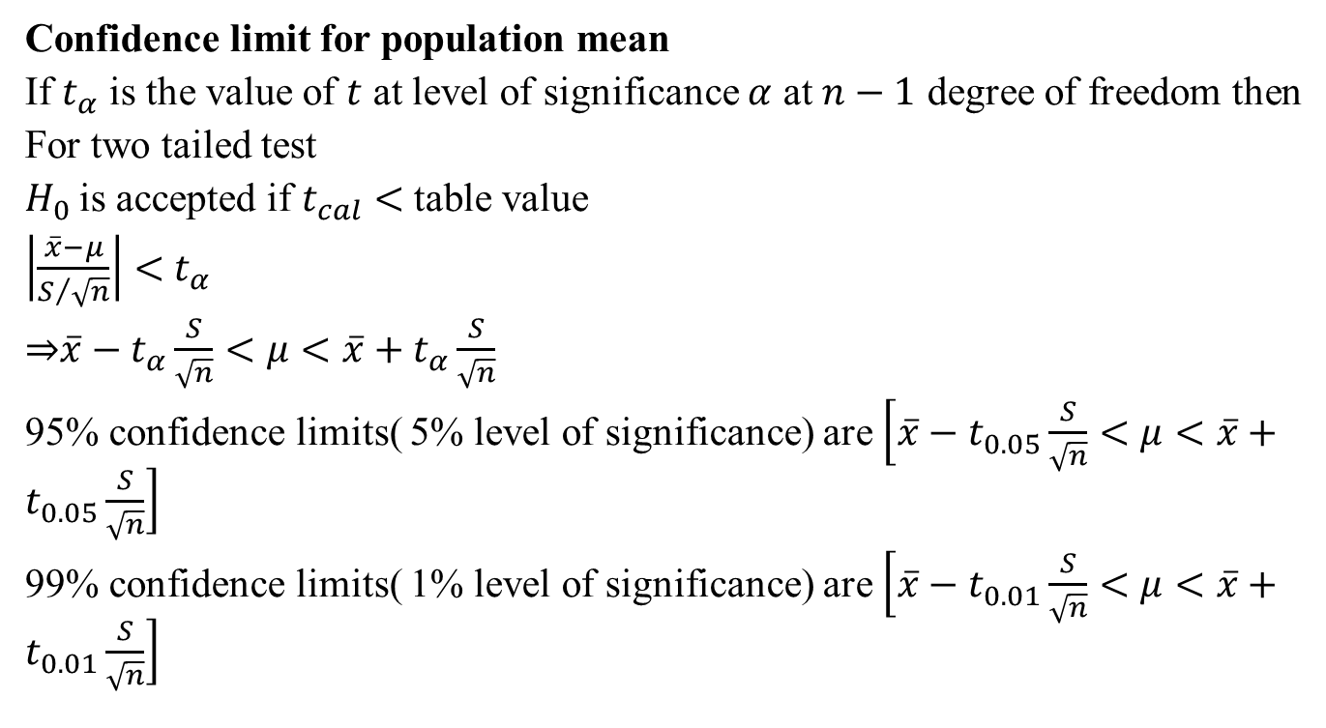
t-Test (CO5)
Confidence limit for population mean
If $t_{α}$ is the value of $t$ at level of significance $α$ at $n−1$ degree of freedom then
For two tailed test
$H_{0}$is accepted if $t_{cal}<$table value
$\left|\frac{\overline{x}−μ}{S/{\sqrt{n}}}\right|<$ $t_{α}$
⇒$\overline{x}−t_{α}\frac{S}{\sqrt{n}}<μ<\overline{x}+t_{α}\frac{S}{\sqrt{n}}$
95% confidence limits( 5% level of significance) are $\left[\overline{x}−t_{0.05}\frac{S}{\sqrt{n}}<μ<\overline{x}+t_{0.05}\frac{S}{\sqrt{n}}\right]$
99% confidence limits( 1% level of significance) are $\left[\overline{x}−t_{0.01}\frac{S}{\sqrt{n}}<μ<\overline{x}+t_{0.01}\frac{S}{\sqrt{n}}\right]$

Slide 58
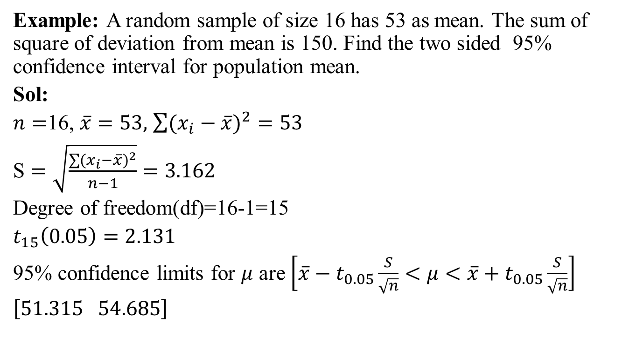
t-Test (CO5)
Example: A random sample of size 16 has 53 as mean. The sum of square of deviation from mean is 150. Find the two sided 95% confidence interval for population mean.
Sol:
$n=$16, $\overline{x}=53,$ $\sum{{(x_{i}−\overline{x})}^{2}}=53$
$\text{S}=\sqrt{\frac{\sum{{(x_{i}−\overline{x})}^{2}}}{n−1}}=3.162$
Degree of freedom(df)=16-1=15
$t_{15}\left(0.05\right)=2.131$
95% confidence limits for $μ$ are $\left[\overline{x}−t_{0.05}\frac{S}{\sqrt{n}}<μ<\overline{x}+t_{0.05}\frac{S}{\sqrt{n}}\right]$
$\left[51.315 54.685\right]$

Slide 59
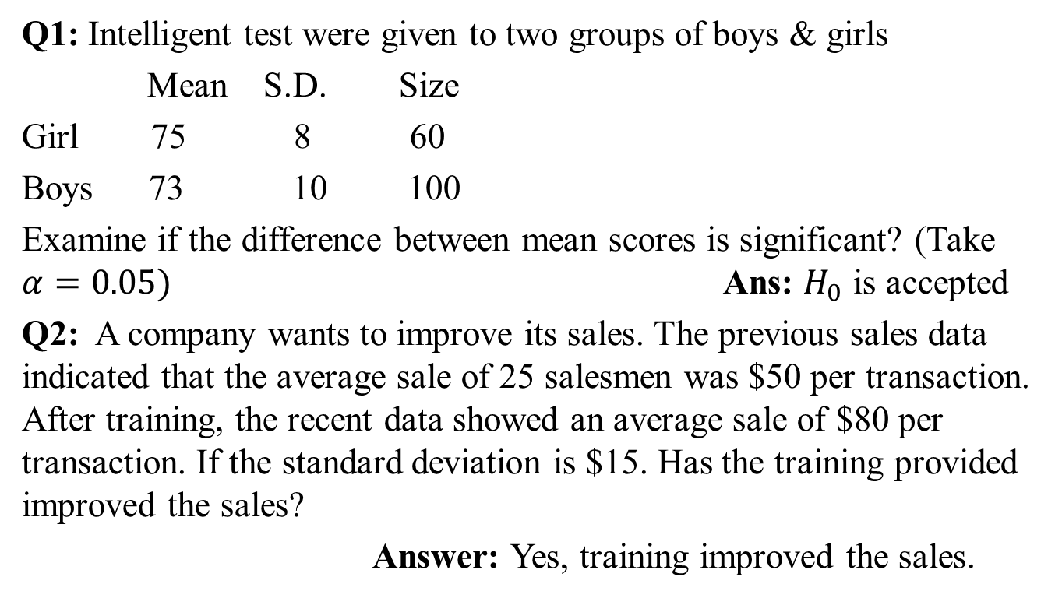
Daily Quiz(CO5)
Q1: Intelligent test were given to two groups of boys & girls
Mean S.D. Size
Girl 75 8 60
Boys 73 10 100
Examine if the difference between mean scores is significant? (Take $α=0.05)$ Ans: $H_{0}$ is accepted
Q2: A company wants to improve its sales. The previous sales data indicated that the average sale of 25 salesmen was $50 per transaction. After training, the recent data showed an average sale of $80 per transaction. If the standard deviation is $15. Has the training provided improved the sales?
Answer: Yes, training improved the sales.

Slide 60
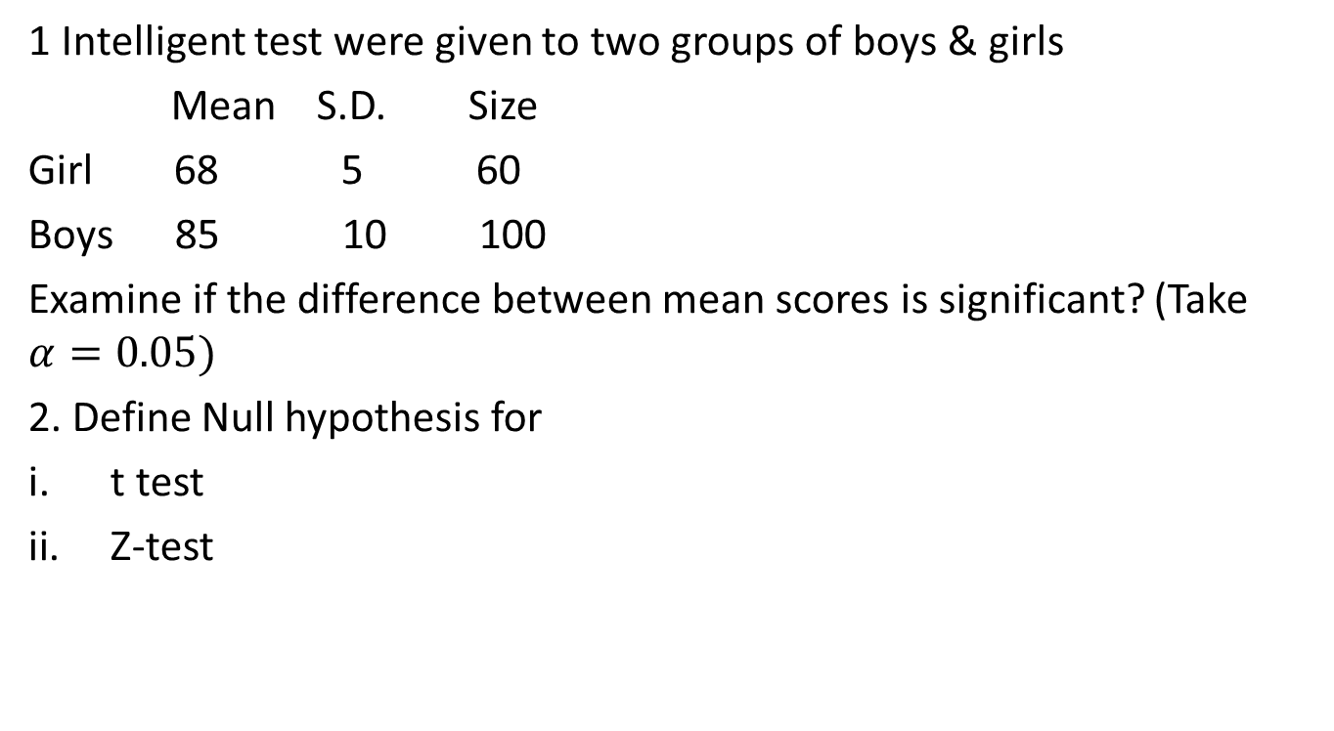
Weekly Assignment(CO5)
1 Intelligent test were given to two groups of boys & girls
Mean S.D. Size
Girl 68 5 60
Boys 85 10 100
Examine if the difference between mean scores is significant? (Take $α=0.05)$
2. Define Null hypothesis for
t test
Z-test

Slide 61
Recap(CO5)
Test of hypothesis
Procedure of Test of hypothesis
Null Hypothesis
Alternate Hypothesis
Level of significance
Test of hypothesis about difference between two population mean
t-Test

Slide 62
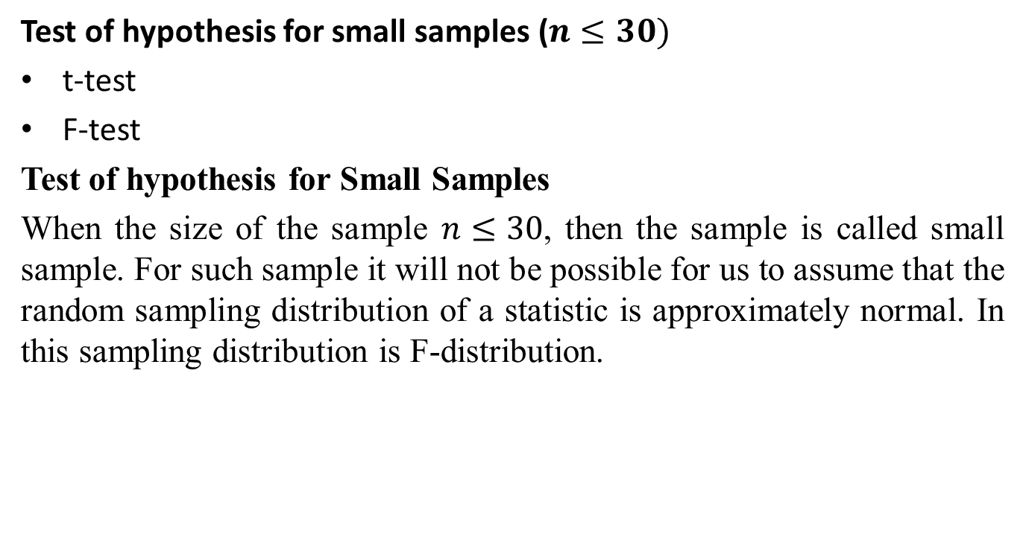
F-Test (CO5)
Test of hypothesis for small samples ($n≤30)$
t-test
F-test
Test of hypothesis for Small Samples
When the size of the sample $n≤30$, then the sample is called small sample. For such sample it will not be possible for us to assume that the random sampling distribution of a statistic is approximately normal. In this sampling distribution is F-distribution.

Slide 63
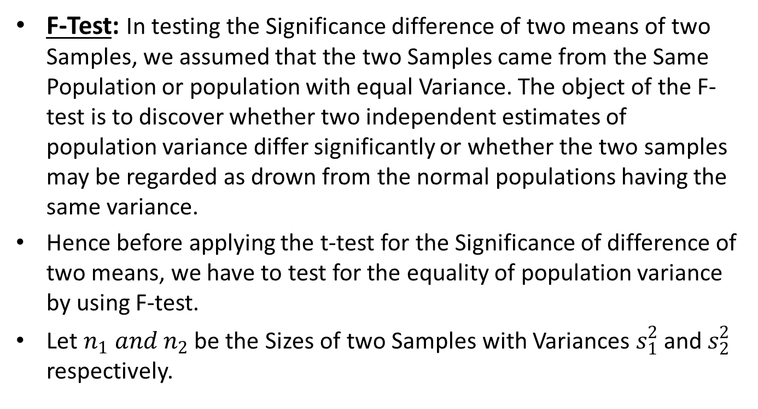
F-Test (CO5)
F-Test: In testing the Significance difference of two means of two Samples, we assumed that the two Samples came from the Same Population or population with equal Variance. The object of the F-test is to discover whether two independent estimates of population variance differ significantly or whether the two samples may be regarded as drown from the normal populations having the same variance.
Hence before applying the t-test for the Significance of difference of two means, we have to test for the equality of population variance by using F-test.
Let $n_{1} and n_{2}$ be the Sizes of two Samples with Variances $s_{1}^{2}$ and $s_{2}^{2}$ respectively.

Slide 64
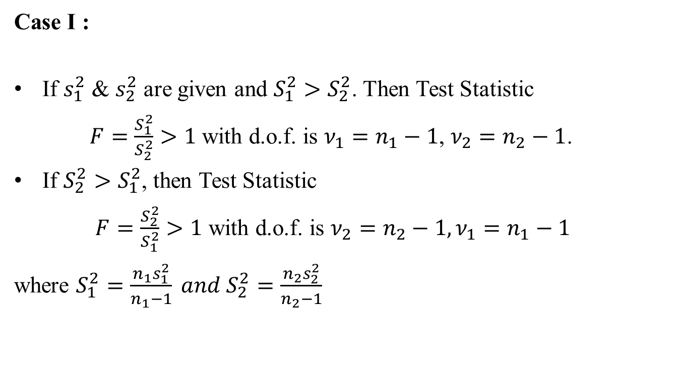
F-Test (CO5)
Case I :
If $s_{1}^{2}$ & $s_{2}^{2}$ are given and $S_{1}^{2}>S_{2}^{2}$. Then Test Statistic
$F=\frac{S_{1}^{2}}{S_{2}^{2}}>1$with d.o.f. is $ν_{1}=n_{1}−1$, $ν_{2}=n_{2}−1$.
If $S_{2}^{2}>S_{1}^{2}$, then Test Statistic
$F=\frac{S_{2}^{2}}{S_{1}^{2}}>1$ with d.o.f. is $ν_{2}=n_{2}−1, ν_{1}=n_{1}−1$
where $S_{1}^{2}=\frac{n_{1}s_{1}^{2}}{n_{1}−1} and S_{2}^{2}=\frac{n_{2}s_{2}^{2}}{n_{2}−1}$

Slide 65

F-Test (CO5)
Case II:
If $s_{1}^{2}$ & $s_{2}^{2}$ are not given and $s_{1}^{2}>s_{2}^{2}$. Then Test Statistic is
$F=\frac{s_{1}^{2}}{s_{2}^{2}},$ with d.o.f. is $ν_{1}=n_{1}−1$, $ν_{2}=n_{2}−1$.
If $s_{1}^{2}$ & $s_{2}^{2}$ are not given and $s_{2}^{2}>s_{1}^{2}$. Then Test Statistic is
$F=\frac{s_{2}^{2}}{s_{1}^{2}},$ with d.o.f. is $ν_{2}=n_{2}−1, ν_{1}=n_{1}−1$.
Where $x_{1}$ and $x_{2}$ are two Samples, $s_{1}^{2}=\frac{\sum{{(x_{1}− {\overline{x}}_{1)}}^{2}}}{n_{1}−1}$ and $s_{2}^{2}=\frac{\sum{{(x_{2}− {\overline{x}}_{2})}^{2}}}{n_{2}−1}$.
Conclusion: Same as t-test.

Slide 66

F-Test (CO5)
Q1.The two random samples reveal the following data:
Test the equality of Population Variance.
Ans. For Checking the equality of Population Variance, we apply F-test.
Null Hypothesis $H_{0}:σ_{1}^{2}=σ_{2}^{2}$ i.e. there is no significant difference between the population Variances.
Alternative Hypothesis $H_{1}:σ_{1}^{2}≠σ_{2}^{2}$
Test Statistic: Since $s_{1}^{2} \&{ s}_{2}^{2}$ are given then
Sample no. | Size | Mean | Variance
I | 16 | 440 | 40
II | 25 | 460 | 42

Slide 67

F-Test (CO5)
Hence $S_{1}^{2}=\frac{n_{1}s_{1}^{2}}{n_{1}−1}=\frac{16X 40}{15}=42.7$
And $S_{2}^{2}=\frac{n_{2}s_{2}^{2}}{n_{2}−1}=\frac{25X 42}{24}$=43.75
Since $S_{2}^{2}>S_{1}^{2}$, Now $F=\frac{S_{2}^{2}}{S_{1}^{2}}=\frac{43.75}{42.7}=1.02$ with degree of freedom is $ν_{2}=n_{2}−1, ν_{1}=n_{1}−1$ i.e.
$υ_{2}=25−1=24 and υ_{1}=16−1=15$.
Conclusion: Here the calculate Value of $F=1.02<F_{(24,15)}=2.29$ at 5% level of Significance. Hence $H_{0}$ is accepted. Therefore population variances are equal.

Slide 68

F-Test (CO5)
Example-2: The height of 6 randomly sailors 63,65,68,69,71 and 72. Those of 9 randomly chosen soldiers are 61,62,65,66,69,70,71,72 and 73. Test the equality of Population Variance. (Test at 5% LOS)
Sol: Let $x_{1}$and $x_{2}$ be two samples denoting the height of sailors & soldiers.
Here $n_{1}=6,n_{2}=9$
Where $s_{1}^{2}=\frac{\sum{{(x_{1}− {\overline{x}}_{1)}}^{2}}}{n_{1}−1}$ and $s_{2}^{2}=\frac{\sum{{(x_{2}− {\overline{x}}_{2})}^{2}}}{n_{2}−1}$
$$\overline{x_{1}}=68,\overline{x_{2}}=67.66$$
Null Hypothesis $H_{0}:σ_{1}^{2}=σ_{2}^{2}$ i.e. there is no significant difference between the population Variances.
Alternative Hypothesis $H_{1}:σ_{1}^{2}≠σ_{2}^{2}$
$$Level of significance α=0.05$$

Slide 69
F-Test (CO5)
$$x_{1}$$ | $$x_{2}$$ | $${(x_{1}−\overline{x_{1}})}^{2}$$ | $${(x_{2}−\overline{x_{2}})}^{2}$$
63 | 61 | 25 | 44.3556
65 | 62 | 9 | 32.0356
68 | 65 | 0 | 7.0756
69 | 66 | 1 | 2.7556
71 | 69 | 9 | 1.7956
72 | 70 | 16 | 5.4756
 | 71 |  | 11.1556
 | 72 |  | 18.8356
 | 73 |  | 28.5156
Total=408 | 609 | 60 | 152.0004

Slide 70

F-Test (CO5)
$s_{1}^{2}=\frac{\sum{{(x_{1}− {\overline{x}}_{1)}}^{2}}}{n_{1}−1}=\frac{60}{5}=12$ and
$s_{2}^{2}=\frac{\sum{{(x_{2}− {\overline{x}}_{2})}^{2}}}{n_{2}−1}=\frac{152.0004}{8}=19.00005$
Test Statistic $F test=\frac{s_{2}^{2}}{s_{1}^{2}}=\frac{19.00005}{12}=1.583375$
$if s_{2}^{2}>s_{1}^{2}$ with degree of freedom is
$ν_{2}=n_{2}−1=9−1=8, ν_{1}=n_{1}−1=6−1=5$.
Table value: $F_{\left(8,5\right)}(0.05)=4.82$
Conclusion : ${\left|F\right|}_{cal}<$ table value
So $H_{0}$ is accepted.
i.e. Therefore population variances are equal.

Slide 71

Daily Quiz(CO5)
Q1: The random samples were drawn from two normal populations and the following results were obtained
Sample 1: 16,17,18,19,20,21,22,24,26,27
Sample 2: 19,22,23,25,26,28,29,30,31,32,35,36
Obtain estimates of the variances of populations and test whether the two populations have the same variances.
(Take $α=0.05$ )
Ans:
Q2: A toy manufacturer wants to get batteries for toys. A team collected 41 samples from supplier A and the variance was 110 hours. The team also collected 21 samples from supplier B with a variance of 65 hours. At a 0.05 alpha level determine if there is a difference in the variances.
Ans: $H_{0}$ is rejected.

Slide 72

Topic Objective (CO5)
Chi Square Test($χ^{2}$)
Distinguish between nonparametric and parametric tests.
Explanation how the test statistic is computed for a chi-square test.
Compute the chi-square goodness-of-fit test and interpret the results.
Identify the assumption and the restriction of expected frequency size for the chi-square test.
Compute the chi-square test for independence and interpret the results.

Slide 73


Chi Square Test($χ^{2}$)(CO5)
Chi Square Test($χ^{2}$)
Chi-square test of goodness of Fit.
Chi-square test of independence of Attributes.

Slide 74


Chi Square Test($χ^{2}$)(CO5)
Chi Square Test($χ^{2}$)
Chi Square test is the test of significance.
Chi square test is a useful measures of comparing experimentally obtained result with those expected theoretically and based on hypothesis.
$χ^{2}=\sum{\frac{{\left(Observed−Expected\right)}^{2}}{Expected}}$
It is a mathematical expression, representing the ratio of experimentally obtained result(O) and theoretically expected result(E) based on certain hypothesis. It uses data in form of frequencies.

Slide 75

Chi Square Test($χ^{2}$)(CO5)
Chi square test is calculated by dividing the square of overall deviation in the observed and expected frequencies by expected frequency. $χ^{2}=\sum{\frac{{\left(O−E\right)}^{2}}{E}}$
O=the frequencies observed, E=the frequencies expected$,Σ$= sum of
If there is no difference between actual and observed frequencies, the value of Chi- Square is zero.
If there is difference between actual and observed frequencies, the value of Chi- Square would be more than zero.
But the difference in the observed frequencies, may also be due to the sampling fluctuations and it should be ignored in drawing interference.

Slide 76
Chi Square Test($χ^{2}$)(CO5)
Degree of Freedom
In test, while comparing the calculated value with the table value, we have to calculate the degree of freedom. The degree of freedom is calculated from the no of classes. Therefore, the no. of degree of freedom in a test is equal to the no. of classes minus one.
If there are two classes, three classes and four classes, the degree of freedom would be 2-1,3-1 and 4-1, respectively. In a contingency table, the degree of freedom is calculated in different manner:
d.f.=(r-1)(c-1)
Where r= no. of row in the table, C= no. of column in the table
Thus in 2×2 contingency table, the degree of freedom is (2-1)(2-1)=1. Similarly, in a 3×3 contingency table, the degree of freedom is (3-1)(3-1)=4.

Slide 77
Chi Square Test($χ^{2}$)(CO5)
Likewise in 3×4 contingency table degree of freedom is (3-1)(4-1)=6, and so on.
Example:2 Rows × 2 columns
Degree of freedom = (r-1)(c-1)=(2-1)(2-1)=1
 | COLUMN 1 | COLUMN 2 | ROW TOTAL
ROW 1 | + | + | RT 1
ROW 2 | + | + | RT 2
COLUMN TOTAL | CT 1 | CT 2

Slide 78

Chi Square Test($χ^{2}$)(CO5)
Application of chi square test
The chi square are applicable in varied problems in agriculture, biology engineering and medical sciences.
To test the goodness of fit.
To test the independence of attributes.
To test the detection of linkage.
To test the homogeneity of independent estimates of the population variance.

Slide 79
Chi Square Test($χ^{2}$)(CO5)
Example: The demand for a particular spare part in a factory was found to vary from day-to-day. In a sample study the following information was obtained:
Under the null hypothesis, the expected frequencies of the spare part demanded on each of the six days would be:(1124+1125+1110+1120+1126+1115)/6=6270/6=1120
Days | Monday | Tuesday | Wednesday | Thursday | Friday | Saturday
No. of parts demanded | 1124 | 1125 | 1110 | 1120 | 1126 | 1115

Slide 80

Chi Square Test($χ^{2}$)(CO5)
Days | Observed ($O_{i}$) | Expected ($E_{i}$) | ($O_{i}−E_{i}$) | $${\text{(}O_{i}−E_{i}\text{)}}^{2}$$
Monday | 1124 | 1120 | 4 | 16
Tuesday | 1125 | 1120 | 5 | 25
Wednesday | 1110 | 1120 | -10 | 100
Thursday | 1120 | 1120 | 0 | 0
Friday | 1126 | 1120 | 6 | 36
Saturday | 1115 | 1120 | -5 | 25
Total | 6720 | 6720

Slide 81

Chi Square Test($χ^{2}$)(CO5)
$χ^{2}=\sum_{i=1}^{n}{\frac{{\left(Observed−Expected\right)}^{2}}{Expected}}$=0.179
The number of degrees of freedom = 6 –1 = 5 (since we are given 6 frequencies subjected to only one linear constraint: ∑$O_{i}$=∑$E_{i}$=6720). The tabulated ${χ^{2}}_{0.05}^{ }$for 5 d.f.= 11.07
Conclusion: Since calculated value of $χ^{2}$is less than the tabulated value, it is not significant and the null hypothesis may accepted at 5% level of significance. Hence we conclude that the numbers of parts demanded are same over the 6-day period.

Slide 82


Chi Square Test($χ^{2}$)(CO5)
Chi square test of Independent of Attributes:
Let us consider two attributes A and B divides into r classes $A_{1,}A_{2},A_{3}…A_{r}$and B divided into s classes $B_{1,}B_{2},B_{3}…B_{s}.$
Such a classification in which attributes are divided into more than two classes is known as manifold classification.
$$χ^{2}=\sum_{i=1}^{r}{\sum_{j=1}^{s}{\frac{[{\left(A_{i}B_{j}\right)−{\left(A_{i}B_{j}\right)}_{o}^{ }]}^{2}}{{\left(A_{i}B_{j}\right)}_{o}^{ }}}\text{=}}\sum_{i=1}^{r}{\sum_{j=1}^{s}{\frac{[{O_{ij}−E_{ij}]}^{2}}{E_{ij}}}}$$

Slide 83

Chi Square Test($χ^{2}$)(CO5)
Where $O_{ij}$=$A_{i}B_{j}$: observed frequency for contingency table category in column i and row j.
$E_{ij}$=${\left(A_{i}B_{j}\right)}_{o}^{ }$: expected frequency for contingency table category in column i and row j.
${\left(A_{i}B_{j}\right)}_{o}^{ }$=$\frac{{(A)}_{i}{(B)}_{j}}{N}$, (i=1,2,3…r,j=1,2,3…s)
Which is distributed as a $χ^{2}$with (r-1)(s-1) d.f.
Example :Two sample polls of votes for two candidates A and B for public office are taken, one from among the resident area of ruler areas. The results are given in the following table. Examine whether the nature of area related to the voting preference in elections.

Slide 84

Chi Square Test($χ^{2}$)(CO5)
Solution : $H_{0}:$ the nature of the area is independent of the voting preference in the election
Expected frequencies
E(620)=$\frac{1170×1000}{2000}=585$
E(380)=$\frac{830×1000}{2000}=415$
E(550)=$\frac{1170×1000}{2000}=585$
Area | Voter for A | Voter for B | Total
Ruler | 620 | 380 | 1000
Urban | 550 | 450 | 1000
Total | 1170 | 830 | 2000

Slide 85

Chi Square Test($χ^{2}$)(CO5)
E(450)=$\frac{830×1000}{2000}=415$
Calculate the statistic $χ^{2}$
=$\frac{{(620−585)}^{2}}{585}$+$\frac{{(380−415)}^{2}}{415}$+$\frac{{(550−585)}^{2}}{585}$+$\frac{{(450−415)}^{2}}{415}$
=10.0891
The tabulated ${χ^{2}}_{0.05}^{ }$for (2-1)(2-1) d.f.= 3.841
Conclusion: since calculate $χ^{2}$is much greater than the tabulated value, it is highly significant and null hypothesis is rejected at 5% of level of significance. Thus we conclude that nature of area is rejected to voting preference in the election.

Slide 86


Chi Square Test($χ^{2}$)(CO5)
Example : What are the expected frequencies of the contingency tables given below:
Observed frequency:
Expected frequency:
$$p$$ | $$q$$ | $$p+q$$
$$r$$ | $$s$$ | $$r+s$$
$$p+r$$ | $$q+s$$ | $$p+q+r+s$$
$$\frac{(p+r)(p+q)}{(p+q+r+s)}$$ | $$\frac{(q+s)(p+q)}{(p+q+r+s)}$$
$$\frac{(p+r)(r+s)}{(p+q+r+s)}$$ | $$\frac{(q+s)(r+s)}{(p+q+r+s)}$$

Slide 87

Chi Square Test($χ^{2}$)(CO5)
Example :To test the effectiveness of inoculation against cholera, the following table was obtained:
( figures represent the number of persons.)
Use $χ^{2}$ test to defend or refute the statement that the inoculation prevents attack from cholera.
Solution : $H_{0}:$the inoculation does not prevents attack from cholera.
 | Attacked | Not Attacked | Total
Inoculated | 30 | 160 | 190
Not Inoculated | 140 | 460 | 600
Total | 170 | 620 | 790

Slide 88



Chi Square Test($χ^{2}$)(CO5)
Expected frequencies
Calculate the statistic $χ^{2}$
$$O_{i}$$ | 30 | 160 | 140 | 690
$$E_{i}$$ | 40.886 | 149.11 | 129.11 | 470.89
$$\frac{{(O_{i}−E_{i})}^{2}}{E_{i}}$$ | 2.898 | 0.795 | 0.918 | 0.252
 | Attacked | Not Attacked
Inoculated | $$\frac{190×170}{790}=40.886$$ | $$\frac{190×620}{790}=149.11$$
Not Inoculated | $$\frac{600×170}{790}=129.11$$ | $$\frac{600×620}{790}=470.89$$

Slide 89

Chi Square Test($χ^{2}$)(CO5)
${χ^{2}}_{cal}^{ }$= $\sum{\frac{{\left(Oi−Ei\right)}^{2}}{Ei}}$ =4.8863
The tabulated ${χ^{2}}_{0.05}^{ }$for (2-1)(2-1) d.f.= 3.841
Conclusion: since calculate $χ^{2}$is much greater than the tabulated value, it is highly significant and null hypothesis is rejected at 5% of level of significance. Hence we defend the statement that inoculation prevents attack from cholera.

Slide 90

Daily Quiz(CO5)
Q1: A sample analysis of examination results of 500 students it was found that 220 students have failed, 170 have secured a third class, 90 have secured a second class and the rest, a first class. Do these figures support the general belief that above categories are in the ratio 4:3:2:1 respectively?(Test at 5 % level of significance)
Ans: $H_{0}$ rejected.
Q2: A sample of 400 students of under graduate and 400 students of post graduate classes was taken to know their opinion about autonomous colleges. 290 of the under graduate and 310 of the post graduate students favored the autonomous status. Present these facts in the form of a table and test at 5% level that the opinion regarding autonomous status of colleges is independent of the level of classes of students.
Ans: $H_{0}$ rejected.

Slide 91

Recap(CO5)
Test of hypothesis
Test of hypothesis about difference between two population mean
To test the significance of the difference between the mean of two small samples.
$χ^{2}$ test

Slide 92
Topic objective (CO5)
Analysis of variance(ANOVA)
Appropriately interpret results of analysis of variance tests.
Distinguish between one and two factor analysis of variance tests.
Identify the appropriate hypothesis testing procedure based on type of outcome variable and number of samples.

Slide 93

Analysis of Variance (ANOVA)(CO5)
ANOVA:
ANOVA is used to determine there is any significant difference between the mean of three or more independent samples.
ANOVA is carried out on the basis of ratio between two variances, this ratio forms the test statistic known as $F$-statistics given by-
$$F=\frac{variance between the samples}{variance with in the sample}$$

Slide 94
Analysis of Variance (ANOVA)(CO5)
ANOVA is to split up the total variation as follows:
Variance between samples.
Variance within samples.
ANOVA classification
One way ANOVA: This is used to see the effect of an independent variable on a given dependent variable.
Two way ANOVA: This is used to see the effect of two independent variable on a given dependent variable.

Slide 95


Analysis of Variance (ANOVA)(CO5)
ANOVA TABLE:
Computation of test statistic
F =$\frac{variance between the samples}{\text{variance} \text{within} \text{the} \text{samples} }=\frac{\text{M}\text{SC}}{\text{MSE} }$
Source of Variation | Sum of Squared | Degree of Freedom | Mean Sum of Squares | Variance Ratio OR F
Between Samples (Column) | SSC | $$c−1$$ | $$MSC=\frac{SSC}{c−1}$$ | F$=\frac{MSC}{MSE}$
With in Samples (Error) | SSE | $$n−c$$ | $$MSE=\frac{SSE}{n−c}$$
Total | SST | $$n−1$$

Slide 96
Analysis of Variance (ANOVA)(CO5)
Q.1 It Is desired to compare three Hospitals with regards to number of deaths per month. A sample of death records of each hospital and the number of deaths was given below. From these data suggest a difference in the no. of the deaths per month among three hospitals.
A | B | C7
3 | 6 | 7
4 | 3 | 3
3 | 3 | 4
5 | 4 | 6
0 | 4 | 5

Slide 97

Analysis of Variance (ANOVA)(CO5)
Sol: Null hypothesis $H_{0 }$:There is no difference in the no. of deaths per months among three hospitals.
Alternate hypothesis $H_{1}$:There is a significant difference in the no. of death per month among three hospitals.
Level of Significance : We use 5% level of Significance.
Test Statistic : To find the Variance ratio F, we set up an ANOVA tables as follows:
Sample totals:
∑$y_{a}=3+4+3+5+0=15$
$∑y_{b}=6+3+3+4+4=20$
$∑y_{c}=7+3+4+6+5=25$

Slide 98

Analysis of Variance (ANOVA)(CO5)
Grand total(T)=$∑y_{a}$+$∑y_{b}+∑y_{c}$=60
Correction factor(C.F)=$\frac{{\left(T\right)}^{2}}{n}$=$\frac{{60}^{2}}{15}=$240
Sum of Squares of Samples:
$∑{y^{2}}_{A}$=$3^{2}$+$4^{2}$+$3^{2}$+$5^{2}$+$0^{2}$=59
$∑{y^{2}}_{B}$=$6^{2}$+$3^{2}$+$3^{2}$+$4^{2}$+$4^{2}$=86
$∑{y^{2}}_{C}$=$7^{2}$+$3^{2}$+$4^{2}$+$6^{2}$+$5^{2}$=135
Total Sum of Squares= $∑{y^{2}}_{A}$+$∑{y^{2}}_{B}$+$∑{y^{2 }}_{C}$ - C.F
=59+86+135-240=40

Slide 99

Analysis of Variance (ANOVA)(CO5)
Sum of Squares between Samples
=$\frac{ \left(∑y_{A}\right) ^{2}}{n_{1}}+\frac{ \left(∑y_{B}\right) ^{2}}{n_{2}}+\frac{ \left(∑y_{C}\right) ^{2}}{n_{3}}−\frac{ \left(T\right) ^{2}}{n}$
=$\frac{ \left(15\right) ^{2}}{5}+\frac{ \left(20\right) ^{2}}{5}+\frac{ \left(25\right) ^{2}}{5}−240$
= 10
Sum of squares with in the samples
= Total sum of squares – sum of squares between the samples
= 40-10
=30

Slide 100

Analysis of Variance (ANOVA)(CO5)
Degree of freedom for total sum of squares =n-1=15-1=14
Degree of freedom for Hospitals=c-1 = 3-1=2
Degree of freedom for Error =n-c =15-3=12
ANOVA TABLE
Source of Variation | Sum of Squared | Degree of Freedom | Mean Sum of Squares | Variance Ratio OR F
Between Samples (Column) | 10 (SSC) | $$2$$ | $$MSC=\frac{SSC}{c−1}=\frac{10}{2}=5$$ | $$F=\frac{MSC}{MSE}=\frac{5}{2.5}=2$$
With in Samples (Error) | 30 (SSE) | $$12$$ | $$MSE=\frac{SSE}{n−c}=\frac{30}{12}=2.5$$
Total | 40 (SST) | $$14$$

Slide 101

Analysis of Variance (ANOVA)(CO5)
The tabular value of F at 5 % level of significance with degree of freedom $ν_{1}$=2 & $ν_{2}=12 is 3.89$:
Conclusion: $F_{cal}<F_{tab},$i. e. $H_{0 }$ is accepted, so the difference is insignificant and we conclude that the data do not suggest a difference in the no of deaths per month among the three hospitals.

Slide 102
Analysis of Variance (ANOVA)(CO5)
Q.2 A manufacturing company purchased three new machines of different makes and wishes to determine whether one of them is faster than the others in producing a certain out put . Five hourly production figures are observed at random from each machine and the results are given below:
Observations | A1 | A2 | A3
1 | 25 | 31 | 24
2 | 30 | 39 | 30
3 | 36 | 38 | 28
4 | 38 | 42 | 25
5 | 31 | 35 | 28

Slide 103

Analysis of Variance (ANOVA)(CO5)
Use ANOVA and determine whether the machines are significantly
Different in their mean speed.(Given at 5% level,F2,12=3.89)
Sol. Null hypothesis H0: Machines are not significantly different in their mean speed i.e.,$μ1=μ2=μ3$.
Alternate hypothesis $H_{1}$:Machines are significantly different in their mean speed.
Level of Significance: We use 5% level of Significance.
Test Statistic: T o find the Variance ratio F, we set up an ANOVA tables as follows: let us shift the origin at 30 i.e., reduce each observations by 30.we have

Slide 104

Analysis of Variance (ANOVA)(CO5)
Sample totals:
∑$A_{1}=−5+0+6+8+1=1$0
$∑A_{2}=1+9+8+12+5=$35
$∑A_{3}=−6+0−2−5−2=−15$
Observations | A1 | A2 | A3
1 | -5 | 1 | -6
2 | 0 | 9 | 0
3 | 6 | 8 | -2
4 | 8 | 12 | -5
5 | 1 | 5 | -2

Slide 105

Analysis of Variance (ANOVA)(CO5)
1. Grand total(T)=$∑A_{1}$+$∑A_{2}+∑A_{3}$=30
2. Correction factor(C.F)=$\frac{{\left(T\right)}^{2}}{n}$=$\frac{{(30)}^{2}}{15}=6$0
Sum of Squares of Samples:
$∑{A^{2}}_{1}$=${(−5)}^{2}$+0+$6^{2}$+$8^{2}$+$1^{2}$=126
$∑{A^{2}}_{2}$=$1^{2}$+$9^{2}$+$8^{2}$+${12}^{2}$+$5^{2}$=315 $∑{A^{2}}_{3}$=${(−6)}^{2}$+$0^{2}$+${(−2)}^{2}$+${(−5)}^{2}$+${(−2)}^{2}$=69
3. Total Sum of Squares= $∑{A^{2}}_{1}$+$∑{A^{2}}_{2}$+$∑{A^{2 }}_{3}$ - C.F
=126+315+69-60=450

Slide 106

Analysis of Variance (ANOVA)(CO5)
Sum of Squares between Samples
=$\frac{ \left(∑A_{1}\right) ^{2}}{n_{1}}+\frac{ \left(∑A_{2}\right) ^{2}}{n_{2}}+\frac{ \left(∑A_{3}\right) ^{2}}{n_{3}}−\frac{ \left(T\right) ^{2}}{n}$
=$\frac{ \left(10\right) ^{2}}{5}+\frac{ \left(35\right) ^{2}}{5}+\frac{ \left(−15\right) ^{2}}{5}−60$
= 250
Sum of squares with in the samples
= Total sum of squares – sum of squares between the samples
= 450-250
=200
Degree of freedom for total sum of squares =n-1=15-1=14
Degree of freedom for Machines=c-1 = 3-1=2

Slide 107

Analysis of Variance (ANOVA)(CO5)
Degree of freedom for Error =n-c =15-3=12
ANOVA TABLE
Source of Variation | Sum of Squared | Degree of Freedom | Mean Sum of Squares | Variance Ratio OR F
Between Samples (Column) | 250 (SSC) | $$2$$ | $$MSC=\frac{SSC}{c−1}=\frac{250}{2}=125$$ | $$F=\frac{MSC}{MSE}=\frac{125}{16.67}=7.498$$
With in Samples (Error) | 200 (SSE) | $$12$$ | $$MSE=\frac{SSE}{n−c}=\frac{200}{12}=16.67$$
Total | 450 (SST) | $$14$$

Slide 108

Analysis of Variance (ANOVA)(CO5)
The tabular value of F at 5 % level of significance with degree of freedom $ν_{1}$=2 & $ν_{2}=12 is 3.89$(given)
Conclusion: $F_{cal}>F_{tab},$ so the null hypothesis is rejected and the difference is significant and we conclude that there is significant difference in the mean speed of the machines.

Slide 109

Recap(CO5)
Test of hypothesis
Test of hypothesis about difference between two population mean
To test the significance of the difference between the mean of two small samples.
$χ^{2}$ test
Anova

Slide 110
Topic objective (CO5)
Control Charts
That process variable can be plotted on a control chart over time. The objective of the control chart is to find any "special" causes of variation as well as to reflect the process improvements that have been made.

Slide 111
Statistical Quality Control (CO5)
Statistical Quality Control (SQC)
SQC refers to the use of statistical methods to monitoring & maintaining the quality of product & services.
Method of SQC:
SQC are applied to two distinct phase of plant operation, they are
Process control
Product control

Slide 112
Statistical Quality Control (CO5)
Process control:
Under the process control, the quality of the product is controlled while the product are in process of production. It is based on prob. Theoretically, It is common that when several identical parts are manufactured some are little large & some are little small but most will be of same size when the frequency or count of the items by size is plotted with size on the horizontal scale and count on the vertical scale a normal curve is obtained. The process control is secured with the technique of control charts.

Slide 113
Statistical Quality Control (CO5)
2. Product control:
Under the product control, the quality of the product is controlled while the product is ready for sale and dispatch to the customers.
The product control is secured with the technique of acceptance sampling. Acceptance sampling is based on premises that a sample represent the whole lot from which the sample is drawn.
In this method samples are taken out & are carefully inspected to detect defects. On the basis of defect found, the lot is accepted or rejected. If defect are few, lot is accepted. It is rejected when defect are more. Thus acceptance sampling is used to take decision regarding acceptance or rejection a lot without examine the entire lot.

Slide 114
Control Charts (CO5)
Control charts: Control chart is a graphical chart for detecting unnatural pattern of variation in the production process and determining the permissible limits of variation. There are 3 horizontal line in control chart-
Control line(CL): it passes through the middle of the chart and parallel is to the base. It represent the prescribed quality of product.
Upper Control limit(UCL): It is shown in the chart by a dotted line that passes through the chart above and parallel to the central line and represent upper limit of tolerance.
Lower Control limit(LCL): It is shown in the chart by a dotted line that passes through the chart below and parallel to the central line and represent lower limit of tolerance.

Slide 115

Control Charts (CO5)

Slide 116

Control Charts (CO5)
Control chart for variables- are used to monitor characteristic that can be measured for e.g- length, weight, diameter, time etc. such charts are of two types-
1. Mean chart ($\overline{x}$ chart)
2. Range chart (R chart)

Slide 117

Control Charts (CO5)
Mean chart ($\overline{x}$ chart): It is used to monitor the change in mean of a process.
Construction of $\overline{x}$ chart:
Compute the mean of each sample.
i.e. $\overline{x_{1}},\overline{x_{2}}……\overline{x_{k}}$ (here $k$ is no. of sample)
Compute the mean of sample mean.
i.e. $\overset{̿}{x}=\frac{\overline{x_{1}}+\overline{x_{2}}+⋯⋯+\overline{x_{k}}}{k}$
Compute the range:
$R=($largest value$−$smallest value) of
each sample i.e. $R_{1},R_{2},……R_{k}.$

Slide 118

Control Charts (CO5)
Compute the mean of sample range
i.e. $\overline{R}=\frac{R_{1}+R_{2}+⋯⋯+R_{k}}{k}$
CL$=\overset{̿}{x}$
UCL$=\overset{̿}{x}+A_{2}\overline{R}$
LCL$=\overset{̿}{x}−A_{2}\overline{R}$
where $A_{2}$ are given in the table and depends upon the sample size.
If the sample mean of each sample lie with in the UCL and LCL then process is in control. If it lie outside then process is out of control.

Slide 119

Control Charts (CO5)
2. Range chart( R-chart)- It is used to monitor the dispersion or variability of the process.
Construction of R-chart-
Compute the range:
$R=($largest value$−$smallest value) of
each sample i.e. $R_{1},R_{2},……R_{k}.$
Compute the mean of sample range
i.e. $\overline{R}=\frac{R_{1}+R_{2}+⋯⋯+R_{k}}{k}$
CL$=\overline{R}$
UCL$=D_{4}\overline{R}$
LCL$=D_{3}\overline{R}$

Slide 120

Control Charts (CO5)
where $D_{4},$ $D_{3}$ are constant whose value depends upon the sample size and coming from table.
If the range of each sample lie with in UCL and LCL then process is in control. If it lie outside then process is out of control.
Example-1: Construct mean chart ($\overline{x}$ chart) and range chart( R-chart) for the following data of 5 samples with each set of 5 items-(conversion factor for $n=5,A_{2}=0.577,$
$D_{3}=0, D_{4}=2.115$)

Slide 121
Control Charts (CO5)
Sample No. | Weights
1 | 20 | 15 | 10 | 11 | 14
2 | 12 | 18 | 10 | 8 | 22
3 | 21 | 19 | 17 | 10 | 13
4 | 15 | 12 | 19 | 14 | 20
5 | 20 | 19 | 26 | 12 | 23

Slide 122


Control Charts (CO5)
Sol:
$\overline{x}$ chart:
$\overline{x_{1}}=\frac{70}{5}=14$ similarly $\overline{x_{2}}=14,\overline{x_{3}}=16,\overline{x_{4}}=16,\overline{x_{5}}=20$
Sample No. | Weights |  |  |  |  | Sample mean | Range $R=L−S$
1 | 20 | 15 | 10 | 11 | 14 | 14 | 10
2 | 12 | 18 | 10 | 8 | 22 | 14 | 14
3 | 21 | 19 | 17 | 10 | 13 | 16 | 11
4 | 15 | 12 | 19 | 14 | 20 | 16 | 8
5 | 20 | 19 | 26 | 12 | 23 | 20 | 14
Total |  |  |  |  |  | 80 | 57

Slide 123

Control Charts (CO5)
$R_{1}=largest−smallest=20−10=10$
$R_{2}=22−8=14$
$R_{3}=11$
$R_{4}=8$
$R_{5}=14$
$\overset{̿}{x}=\frac{\overline{x_{1}}+\overline{x_{2}}+⋯⋯+\overline{x_{5}}}{5}=\frac{80}{5}=16$
$\overline{R}=\frac{R_{1}+R_{2}+⋯⋯+R_{5}}{5}=\frac{57}{5}=11.4$
CL$=\overset{̿}{x}=16$
UCL$=\overset{̿}{x}+A_{2}\overline{R}=22.577$ here $A_{2}=0.577$ (Given) LCL$=\overset{̿}{x}−A_{2}\overline{R}=9.423$

Slide 124

Control Charts (CO5)

Slide 125

Control Charts (CO5)
R-chart:
CL$=\overline{R}=11.4$
UCL$=D_{4}\overline{R}=24.09$ $\left(∵D_{4}=2.115\right)$
LCL$=D_{3}\overline{R}=0$ $\left(∵D_{3}=0\right)$

Slide 126

Control Charts (CO5)

Slide 127
Daily Quiz(CO5)
Q1. An inspection of 10 samples of size 100 each from 10 lots reveal the following number of defectives: 16,18,11,18,21,10,20,18,17,21. Do these indicate that the quality characteristics inspected is under statistical control.
Ans. Process is in under statistical control
Q2. A machine drills hole in a pipe with a mean diameter of 0.532 cm and a standard deviation of 0.002 cm. Calculate the control limits for mean of samples 5.
Ans. CL=0.532, UCL=0.5346, LCL=0.5293

Slide 128

Control Charts (CO5)
Control chart for attributes: are used to monitor characteristic that have discrete values & can be counted. e.g- percentage of defective etc. such charts are of three types-
$p$-chart( fraction/proportion defective chart)
$np$-chart(no. of defective chart)/d-chart
C-chart( no. of defect per Module chart)

Slide 129

Control Charts (CO5)
$p$-chart: is designed to control the percentage or proportion/fraction of defective per samples.
Construction of $p$-chart:
Calculate fraction defective $p$ for each sample
i.e. Fraction defective $p=\frac{no. of defective item}{size of the sample}$
Calculate avg. fraction defective $\left(\overline{p}\right)$
i.e. $\overline{p}=\frac{Total no. of defective}{Total no. of unit inspected}$

Slide 130

Control Charts (CO5)
CL$=\overline{p}$
UCL$=\overline{p}+3\sqrt{\frac{\overline{p}\left(1−\overline{p}\right)}{n}}$
LCL$=\overline{p}−3\sqrt{\frac{\overline{p}\left(1−\overline{p}\right)}{n}}$
where$n=\frac{total no. of unit inspected}{no.of sample}$
If the fraction defective of each sample lie with in the UCL and LCL then process is in control. If it lie outside then process is out of control.

Slide 131
Control Charts (CO5)
Example-1 The following data refers to visual defects found during the inspection of the first 10 samples of size 100 each from a lot of two wheelers manufactured by automobile company:
Construct a control chart for fraction defective. What conclusions you draw from the control chart?
No. of samples (each of 100 items) | 1 | 2 | 3 | 4 | 5 | 6 | 7 | 8 | 9 | 10
No. of defectives | 5 | 3 | 3 | 6 | 5 | 6 | 8 | 10 | 10 | 4

Slide 132

Control Charts (CO5)
Sol: Here no of sample $k=10$
No. of samples | No. of units in sample | No. of defective (d) | Fraction defective (p)
1 | 100 | 5 | 0.05
2 | 100 | 3 | 0.05
3 | 100 | 3 | 0.03
4 | 100 | 6 | 0.06
5 | 100 | 5 | 0.05
6 | 100 | 6 | 0.06
7 | 100 | 8 | 0.08
8 | 100 | 10 | 0.1
9 | 100 | 10 | 0.1
10 | 100 | 4 | 0.04
Total | 1000 | 60 | 0.60

Slide 133

Control Charts (CO5)
Avg. fraction defective $\overline{p}=\frac{Total no. of defective}{Total no. of unit inspected}=\frac{60}{10×100}=0.06$
$$n=\frac{total no. of unit inspected}{no.of sample}=\frac{10×100}{10}=100$$
Now CL$=\overline{p}=0.06$
UCL$=\overline{p}+3\sqrt{\frac{\overline{p}\left(1−\overline{p}\right)}{n}}=0.1311$
LCL$=\overline{p}−3\sqrt{\frac{\overline{p}\left(1−\overline{p}\right)}{n}}=−0.0112$
Here LCL is negative so we take LCL=0.

Slide 134

Control Charts (CO5)

Slide 135

Control Charts (CO5)
$np$-chart: when the sample size remain constant, $np$- chart is used to control the actual no. of defective per sample. The construction of $np$-chart is similar to $p$- chart because in this chart we can directly plot the no. of defective rather than fraction of defective.
Construction of $np$-chart:
Calculate avg. fraction defective $\left(\overline{p}\right)$
i.e. $\overline{p}=\frac{Total no. of defective}{Total no. of unit inspected}$
CL$=n\overline{p}$, UCL$=n\overline{p}+3\sqrt{n\overline{p}\left(1−\overline{p}\right)}$, LCL$=n\overline{p}−3$ $\sqrt{n\overline{p}\left(1−\overline{p}\right)}$
where $n=\frac{total no. of unit inspected}{no.of sample}$
If the no. of defectives of each sample lie with in the UCL and LCL then process is in control. If it lie outside then process is out of control.

Slide 136

Control Charts (CO5)
Example-1: An inspection of 10 samples of size 400 each from 10 lots reveal the following number of defectives: 17,15,14,26,9,4,19,12,9,15
Calculate the control limits for the number of defective units. Plot on the graph and state whether the process is under control or not.
Sol: Here no. of samples$=10$
Size of sample:
$$n=\frac{total no. of unit inspected}{no.of sample}=\frac{10×400}{10}=400$$
Avg. fraction defective $\overline{p}=\frac{Total no. of defective}{Total no. of unit inspected}=\frac{140}{400×10}=0.035$
CL$=n\overline{p}=$14
UCL$=n\overline{p}+3\sqrt{n\overline{p}\left(1−\overline{p}\right)}=25.025$
LCL$=n\overline{p}−3$ $\sqrt{n\overline{p}\left(1−\overline{p}\right)}=2.97$5

Slide 137

Control Charts (CO5)

Slide 138

Control Charts (CO5)
C-chart: is used when the no. of defect per Module are counted. Here C represent the no. of defects per Module (per item)
Construction of C-chart:
Calculate $\overline{C}=\frac{No. of defect in all samples}{total no. of samples}$
CL$=\overline{C}$
UCL$=\overline{C}+3\sqrt{\overline{C}}$
LCL$=\overline{C}−3$ $\sqrt{\overline{C}}$
If the no. of defects with in the UCL and LCL then process is in control. If it lie outside then process is out of control.

Slide 139

Control Charts (CO5)
Example-1 Ten pieces of cloth out of different rolls of equal length contained the following defects: 1,3,5,0,6,0,9,4,4,3
Draw a control chart for the no. of defects and state whether the process is in state of statistical control.
Sol: $\overline{C}=\frac{No. of defect in all samples}{total no. of samples}=\frac{35}{10}=3.5$
CL$=\overline{C}=3.5$
UCL$=\overline{C}+3\sqrt{\overline{C}}=9.112$
LCL$=\overline{C}−3$ $\sqrt{\overline{C}}=−2.112$
here LCL is negative so LCL=0

Slide 140

Control Charts (CO5)

Slide 141
Daily Quiz(CO5)
Q1 The no. of defective needles of sewing machines has been given in the following table on the basis of daily inspection:
Prepare p-chart and state whether the production process is in control.
Ans: Process is not in control.
Q2: A process monitors the number of defects per day in the production Module and counts for 5 days are: [4, 6, 3, 5, 7]. Construct a C-chart.
Ans: The UCL is 11.71 and LCL is 0.
Day | 1 | 2 | 3 | 4 | 5 | 6 | 7 | 8 | 9 | 10
Needle inspected | 90 | 60 | 70 | 100 | 120 | 50 | 100 | 110 | 100 | 100
No. of defective needle | 5 | 12 | 7 | 3 | 6 | 5 | 10 | 6 | 8 | 25

Slide 142
Faculty Video Links, Youtube & NPTEL Video Links and Online Courses Details(CO5)
Self Made Video Link:
Test of hypothesis
https://youtu.be/h-NtACvrPfQ
Test of hypothesis for large samples-Z-test
https://youtu.be/a8MYgSRknmI
Test of hypothesis for large samples-t test
https://youtu.be/msJXJgrY1t4
F-test
https://youtu.be/argjx9DJdxY
Chi square Test
https://youtu.be/ayaa7_e1cIA

Slide 143
Faculty Video Links, Youtube & NPTEL Video Links and Online Courses Details(CO5)
Self Made Video Link:
Statistical quality control & control chart for Variable https://youtu.be/89bs12h_Cg0
Control chart for attributes https://youtu.be/q6BwAotTI04

Slide 144
Faculty Video Links, Youtube & NPTEL Video Links and Online Courses Details(CO5)
Suggested video link
Testing of hypothesis
https://nptel.ac.in/content/storage2/courses/103106120/LectureNotes/Lec3_1.pdf

Slide 145

Weekly Assignment (CO5)
1.The following table gives the yields of four varieties of wheat grown in two plots:
Is there any significant difference in the production of these varieties?(F value for (8,3)d.f = 4.07 and for (2,6)d.f = 5.14)
Ans. $F_{cal}=0.385$; Significant
2. The following figures relate to producting in kg. of three varieties A,B and C of wheat shown in 12 plots :
Plots | Varieties
 | A | B | C | D
1 | 200 | 230 | 250 | 300
2 | 190 | 270 | 300 | 270
3 | 240 | 150 | 145 | 180

Slide 146

Weekly Assignment (CO5)
A :- 14 16 18
B :- 14 13 15 22
C :- 18 16 19 19 20
Is there any significant difference in the production of these varieties?(F value for (2,9)d.f = 4.261 ) Ans. $F_{cal}=1.125$; Significant
3. The number of defects per Module in a Sample of 330 units of a manufactured product was found as follows
No. of defects | 0 | 1 | 2 | 3 | 4
No. of units | 214 | 92 | 20 | 3 | 1

Slide 147

Weekly Assignment (CO5)
(Given as 5% level of significance, the value of $χ^{ 2}$ for 1 d.f = 3.84). Ans. ${χ^{ 2}}_{cal}=0.0295$; Significant
4. A milk producer’s union wishes to test whether the preference pattern of consumers for its product is dependent on income levels. A random sample of 500 individuals gives the following data:
Income |  | Product Preferred
 |  | Product A | Product B |  | Product C | Total
Low |  | 170 | 30 |  | 80 | 280
Medium |  | 50 | 25 |  | 60 | 135
High |  | 20 | 10 |  | 55 | 85
Total | 240 |  | 65 | 195 |  | 500

Slide 148

Weekly Assignment (CO5)
Can you conclude that the preference patterns are independent of income levels?(Given as 5% level of significance, the value of $χ^{ 2}$ for 4 d.f = 9.49). Ans. ${χ^{ 2}}_{cal}=51.036$; Not Significant
5. Ten pieces of cloth out of different rolls of equal length contained the following number of defects: 1, 3, 5, 0, 6, 0, 9, 4, 4, 3. Draw a control chart for the number of defects and state whether the process is in a state of statistical control.
Ans. Process is in under statistical control

Slide 149

MCQ s (CO5)
1. A sample of 20 items has mean 42 units and S.D. 5 units. It is a random sample from a normal population with mean 45 units. Then in test of hypothesis we get the following results? For this data $t_{tab}=2.09$ at 5% level of significance.
D.f. $γ=19$
${\left|t\right|}_{cal}=2.615$
$H_{1}$ accepted
There is significant difference between the sample mean and population mean.
2. A random sample of 900 members has mean 3.4cms. If it is reasonably regarded as a sample from a large population of mean 3.2cms and S.D. 2.3 cms. If the tabulated value for this

Slide 150

MCQ s (CO5)
data is 1.96 at 5% level of significance. Then the following results are true.
Use t-test for single mean.
Use z-test for single mean.
Use z-test for double mean.
$H_{0}$ is accepted.
3.While testing the significance of difference of two sample means in case of small sample, how is degree of freedom calculated?
a) $n_{1}−1$ b) $n_{1}+n_{2}−2$ c) $\left(n_{1}−1\right)+\left(n_{2}−1\right)$ d) $n_{2}−1$

Slide 151

MCQs (CO5)
4. What type of chart will be used to plot the number of defectives in the output of any process? a) $\overline{X}$ chart b) R chart c) c chart d) p chart
5. Consider a hypothesis H₀ where µ = 5 against H₁ where µ > 5. The test is? a) Right tailed b) Left tailed c) Center tailed d) Cross tailed

Slide 152
Glossary Questions (CO5)
Pick out the correct option from Glossary-
z-test
F-test
t-test
Chi Square test
Is used to test the significance for small sample
Is used to test the significance for large sample
Is also known as variance ratio test
Is used to test the independence of attributes

Slide 153
Glossary Questions (CO5)
Pick out the correct option from Glossary-
np-chart
p-chart
c-chart
Control chart for variables
Fraction defective chart
No. of defective chart
No. of defect chart
Mean chart

Slide 154
Old Question Papers (CO5)
First Sessional Set-1 (CSE,IT,CS,ECE,IOT).docx
Second Sessional Set-2 (CSE,IT,CS,ECE,IOT).docx
Maths IV PUT.docx
Maths IV final paper_2022.pdf

Slide 155


End Semester Question Paper

Slide 156


End Semester Question Paper

Slide 157


End Semester Question Paper

Slide 158

End Semester Question Paper

Slide 159

End Semester Question Paper

Slide 160

End Semester Question Paper

Slide 161

End Semester Question Paper

Slide 162

End Semester Question Paper

Slide 163

End Semester Question Paper

Slide 164

End Semester Question Paper

Slide 165

End Semester Question Paper

Slide 166
References
Text Books
N. P. Bali: A Textbook of Engineering Mathematics-IV, University Science Press.
H. K. Dass: Introduction to Engineering Mathematics, S. Chand.
S. Ross: A First Course in Probability, 6th Ed., Pearson Education India, 2002.
W. Feller, An Introduction to Probability Theory and its Applications, Vol. 1, 3rd Ed., Wiley, 1968.

Slide 167
References
Reference Books
P. G. Hoel, S. C. Port and C. J. Stone, Introduction to Probability Theory, Universal Book Stall, 2003(Reprint).
R.K. Jain and S.R.K. Iyenger: Advance Engineering Mathematics; Narosa Publishing House, New Delhi.
J.N. Kapur: Mathematical Statistics; S. Chand & Sons Company Limited, New Delhi.
D.N.Elhance,V. Elhance & B.M. Aggarwal: Fundamentals of Statistics; Kitab Mahal Distributers, New Delhi.

Slide 168
Thank You

